Slide 1
Blind Test Healthy vs Head and Neck Cancer Plasma Samples

Slide 2
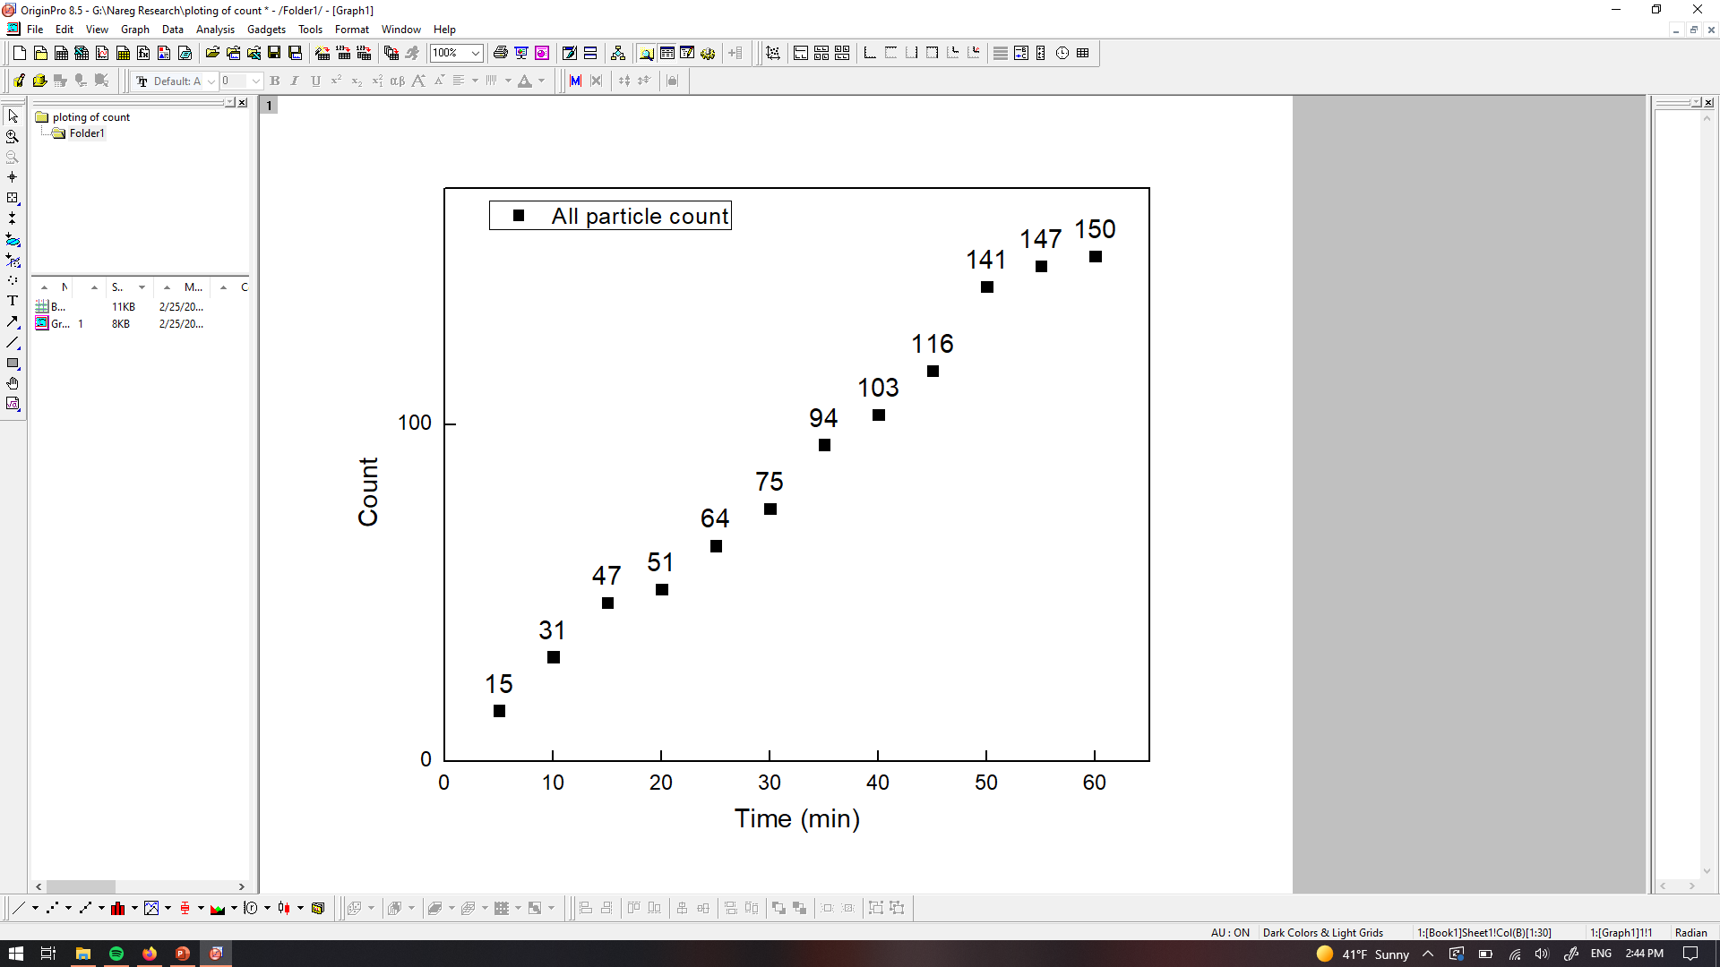
PANORAMA of Plasma Sample 1 (Prediction: Healthy)
Time: 60 min
Count: 150 (Ex: 55; Large: 95)
Time: 60 min wash
Count: 22
Based On Count: Before wash count matches CI Healthy (64-172)
After wash count matches CI Healthy (7-28)
Note: 0 % response to miRNA-21
Scale bar: 10 µm

Slide 3
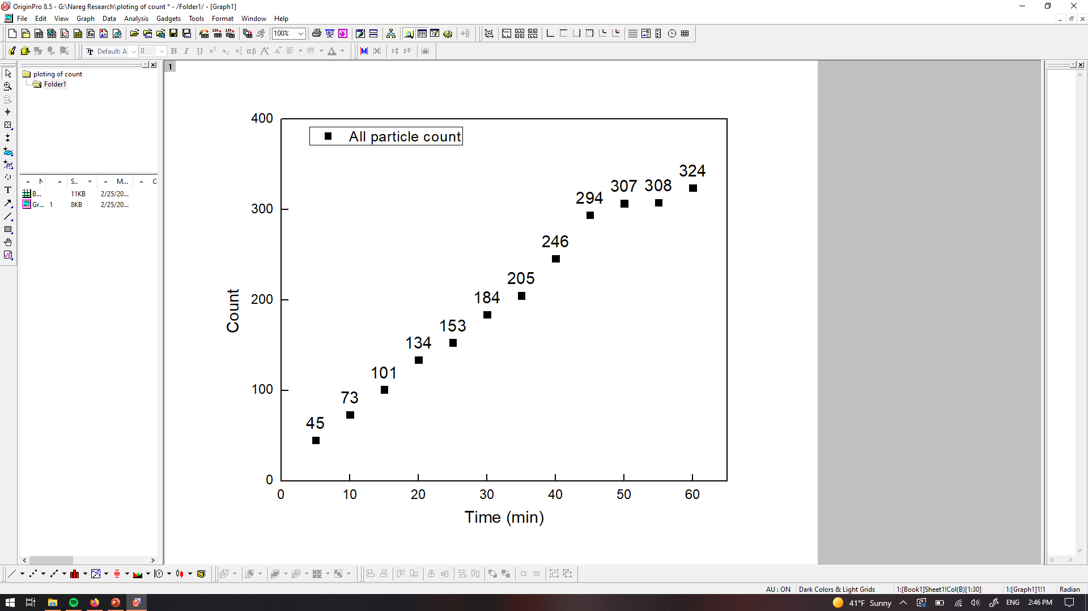
PANORAMA of Plasma Sample 2 (Prediction: Healthy (45%))
Time: 60 min
Count: 324 (Ex: 239; Large: 85)
Time: 60 min wash
Count: 63
Based On Count: Before wash count higher CI Healthy (64-172)
After wash count higher CI Healthy (7-28)
Note: 0 % response to miRNA-21
Scale bar: 10 µm

Slide 4
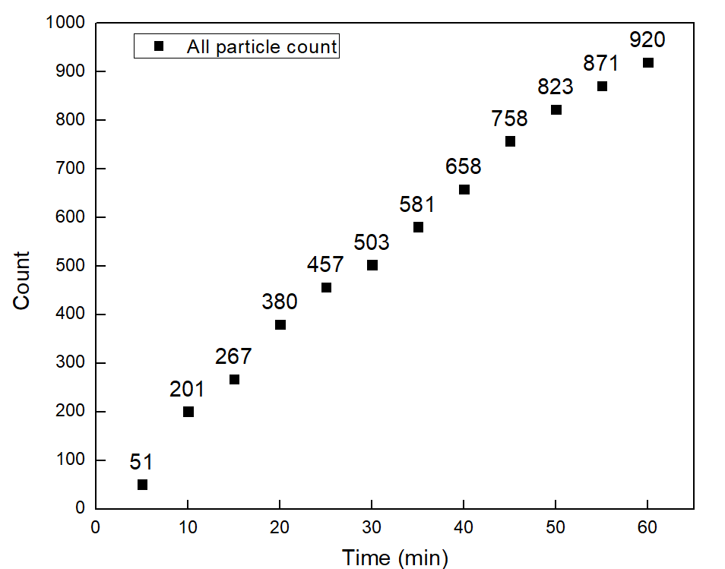
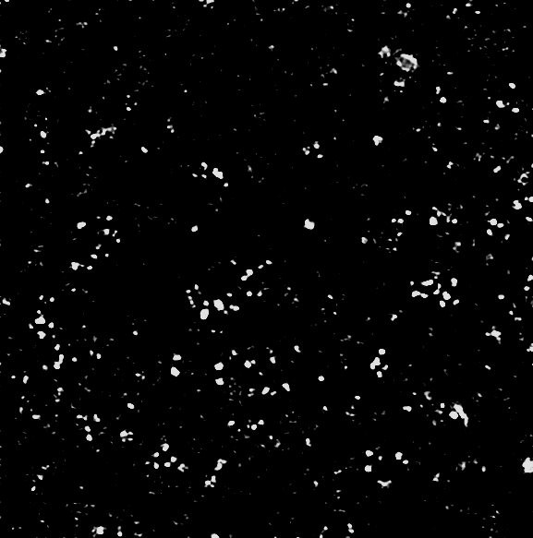

PANORAMA of Plasma Sample 3 (Prediction: Cancer (40%))
Time: 60 min
Count: 920 (Ex: 625; Large: 284)
Time: 60 min wash
Count: 114
Based On Count: Before wash count barely match CI of stage 1 (950-1558)
After wash lower than CI stage 1 (151-370) and significantly higher then Healthy (7-28)
Note: 3 % response to miRNA-21
Scale bar: 10 µm

Slide 5
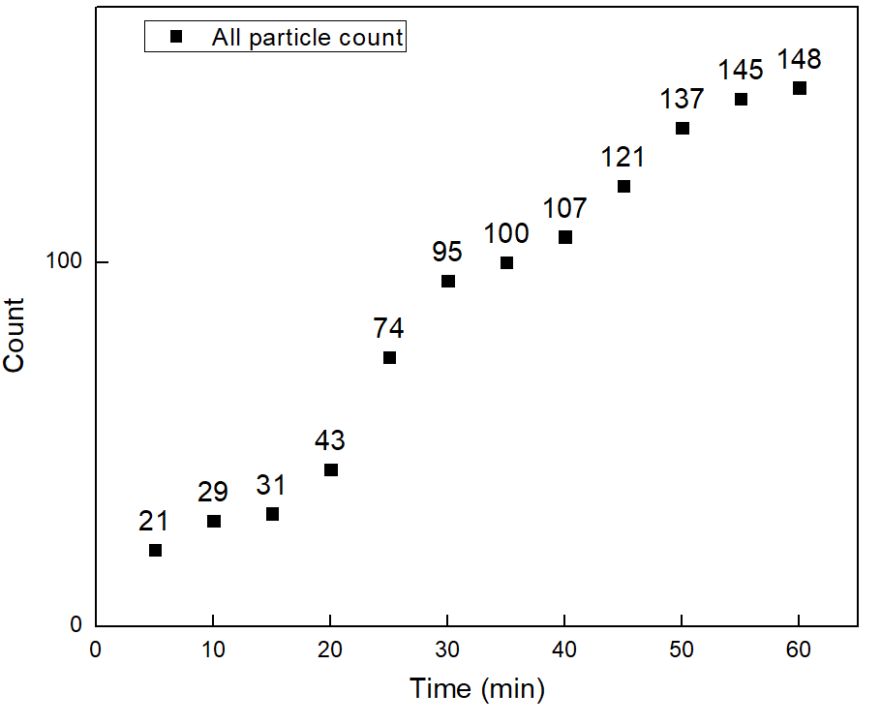

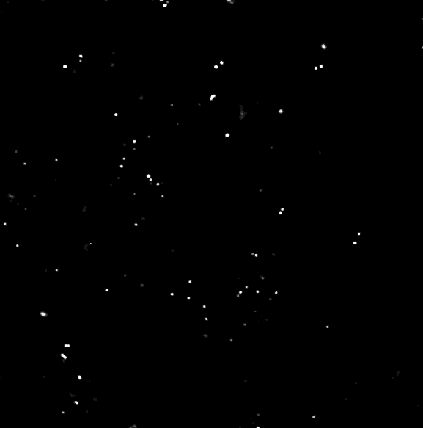
PANORAMA of Plasma Sample 4 (Prediction: Healthy (58%)
Time: 60 min
Count: 148 (Ex:133; Large:15)
Time: 60 min wash
Count: 55
Based On Count: Before wash count between CI of stage 1 (950-1558) and Healthy (64-172)
After wash count matches CI for stage 1 (151-370) and Healthy (7-28)
Note: 0 % response to miRNA-21
Scale bar: 10 µm

Slide 6
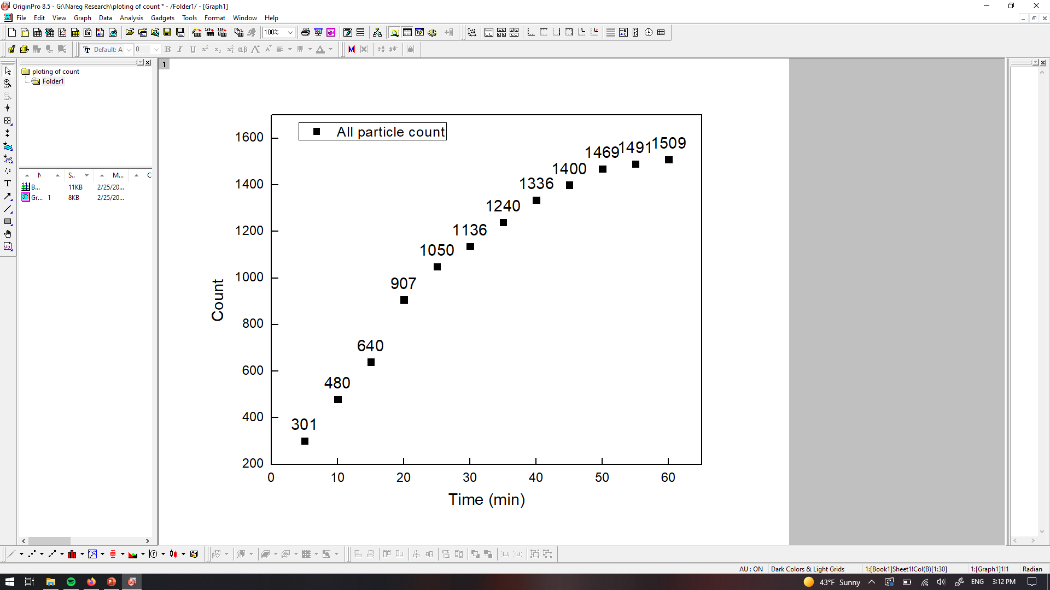

PANORAMA of Plasma Sample 5 (Prediction: Cancer)
Time: 60 min
Count: 1509 (Ex: 1449; Large: 60)
Time: 60 min wash
Count: 210
Based On Count: Before wash count matches CI of stage 1 (950-1558)
After wash count matches CI for stage 1 (151-370
Note: 0 % response to miRNA-21
Scale bar: 10 µm

Slide 7

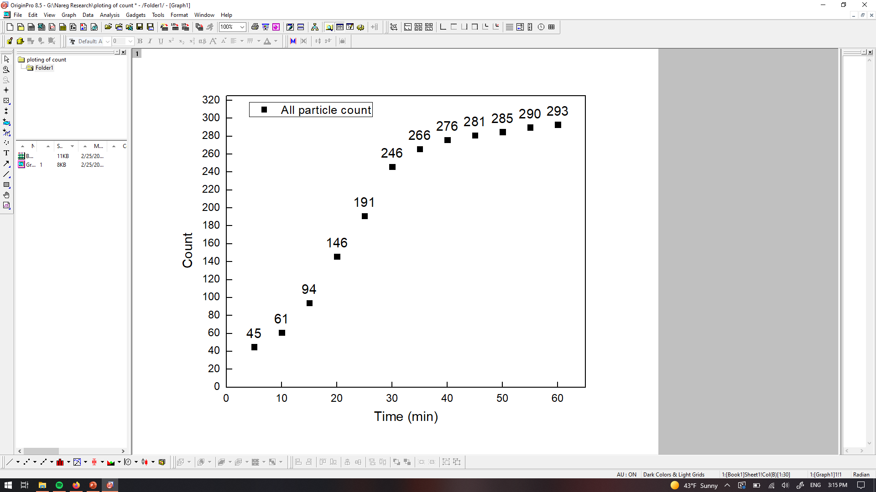
PANORAMA of Plasma Sample 6 (Prediction: Healthy (93%))
Time: 60 min
Count: 293 (Ex: 180; Large: 103)
Time: 60 min wash
Count: 32
Based On Count: Before wash count higher CI Healthy (64-172)
After wash count slightly higher matches (7-28)
Note: 0 % response to miRNA-21
Scale bar: 10 µm

Slide 8
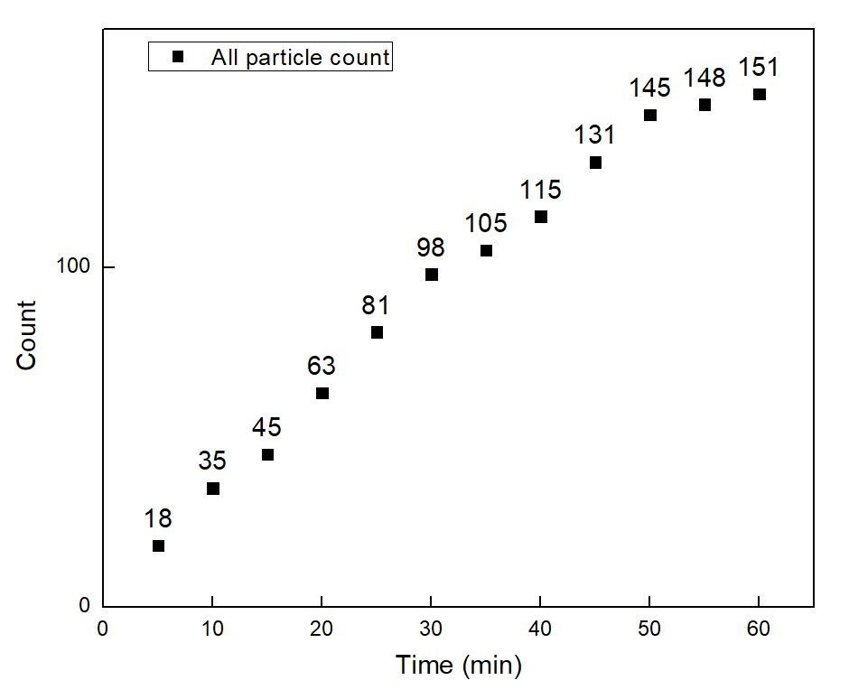

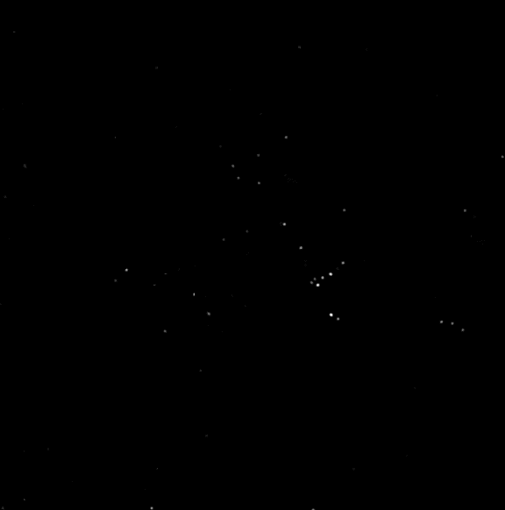
PANORAMA of Plasma Sample 7 (Prediction: Healthy (71%))
Time: 60 min
Count: 151 (Ex: 99; Large: 52)
Time: 60 min wash
Count: 45
Based On Count: Before wash count matches Healthy (64-172)
After wash count slightly higher CI Healthy (7-28)
Note: 0 % response to miRNA-21
Scale bar: 10 µm

Slide 9
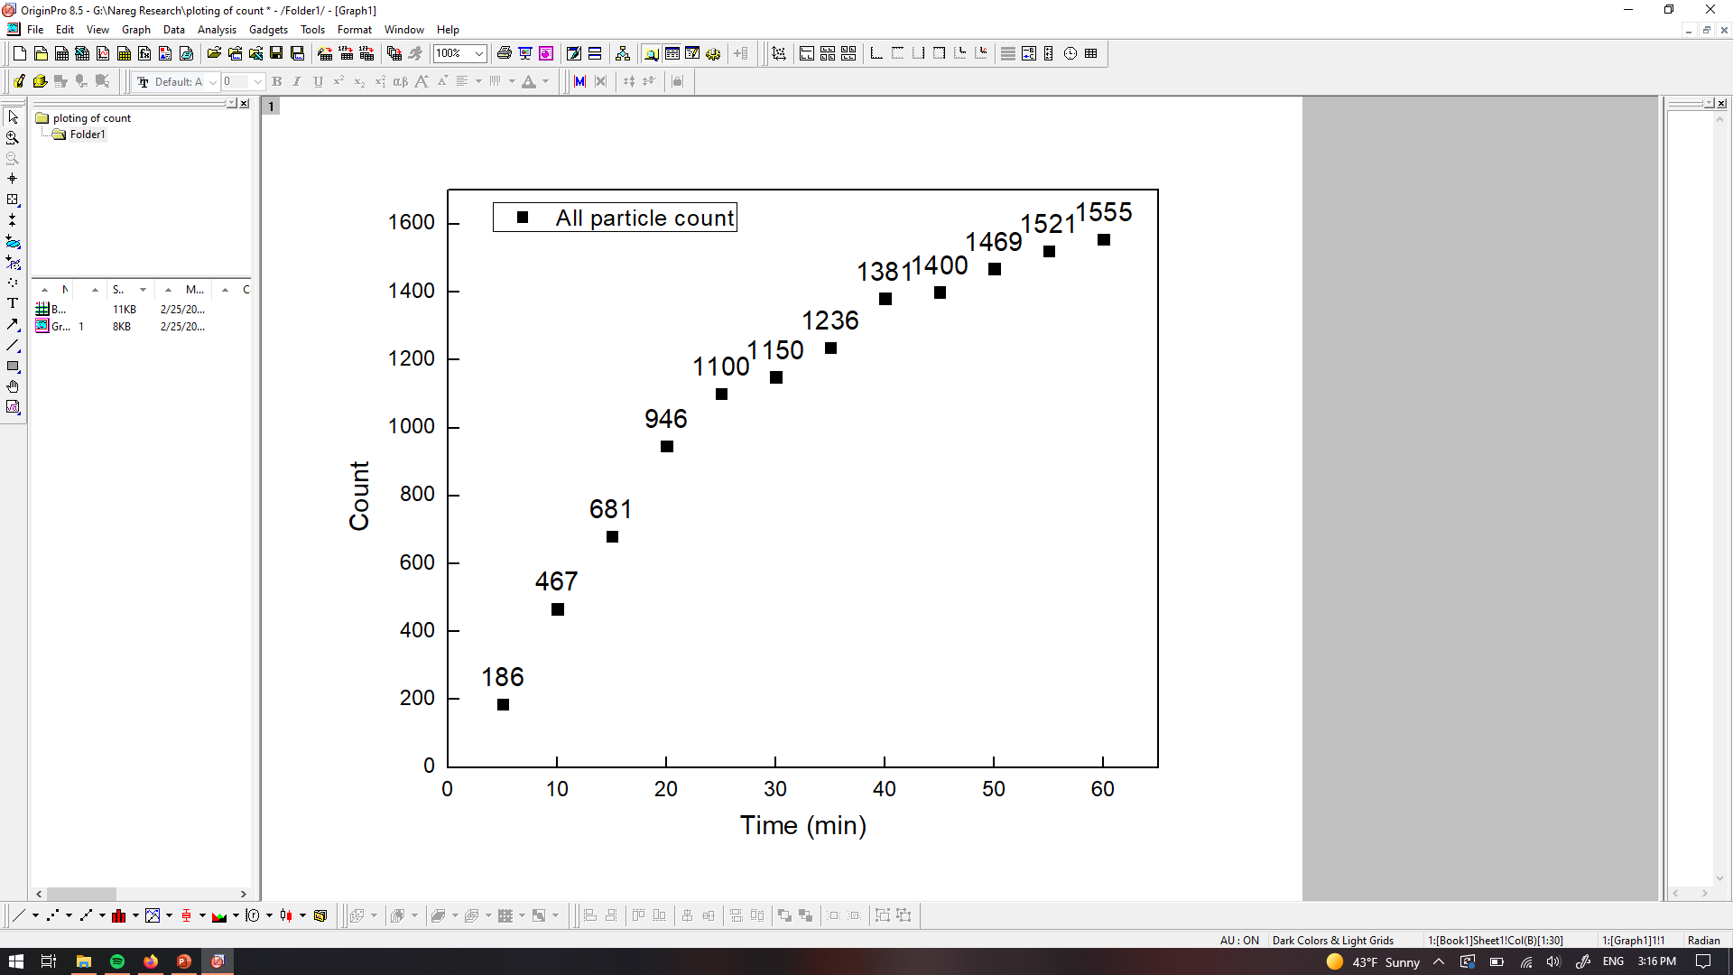
PANORAMA of Plasma Sample 8 (Prediction: Cancer)
Time: 60 min
Count: 1555 (Ex: 1101; Large: 454)
Time: 60 min wash
Count: 538
Based On Count: Before wash count matches CI of stage 1 (950-1558)
After wash count Exceeds CI for stage 1 (151-370)
Note: 37% % response to miRNA-21
Scale bar: 10 µm

Slide 10
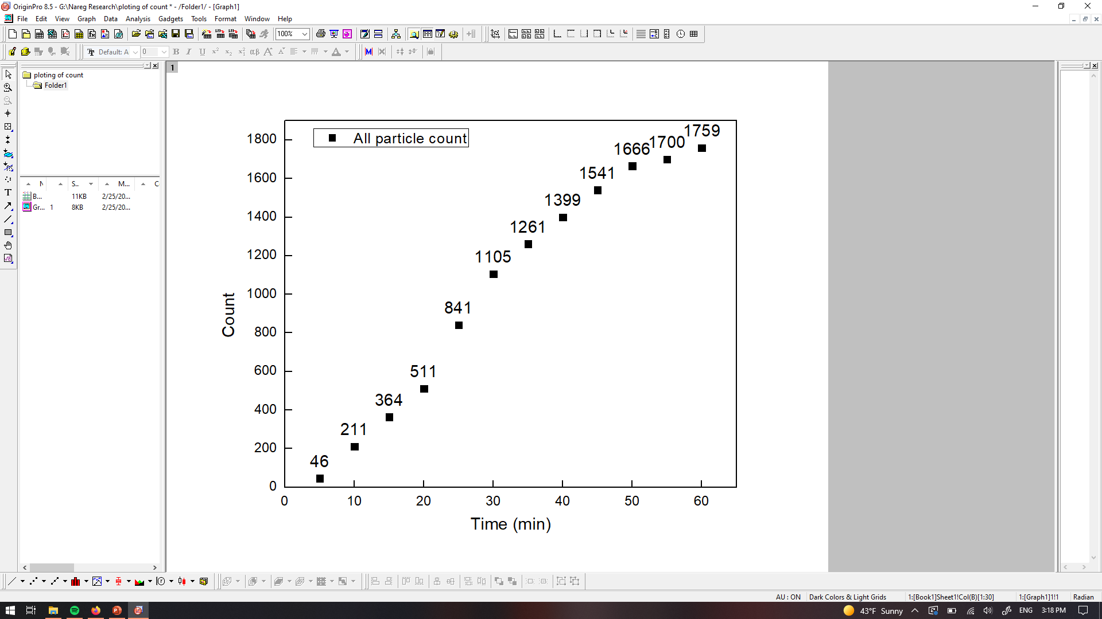
PANORAMA of Plasma Sample 9 (Prediction: Cancer)
Time: 60 min
Count: 1759 (Ex: 1409; Large: 350)
Time: 60 min wash
Count: 315
Based On Count: Before wash count exceeds CI of stage 1 (950-1558)
After wash count matches CI for stage 1 (151-370)
Note: 7.9 % response to miRNA-21
Scale bar: 10 µm

Slide 11
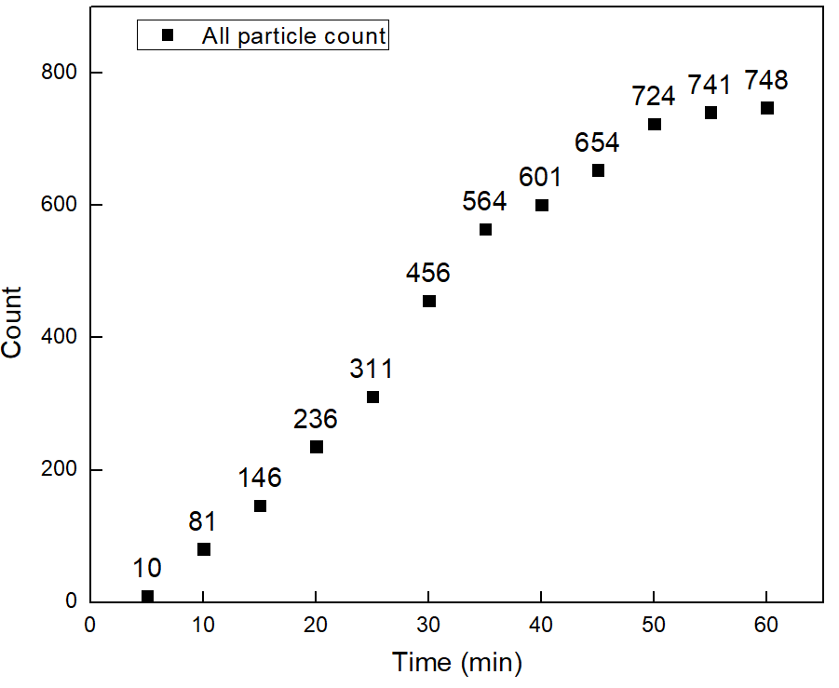


PANORAMA of Plasma Sample 10 (Prediction: Cancer)
Time: 60 min
Count: 748 (Ex: 491; Large: 257)
Time: 60 min wash
Count: 395
Based On Count: Before wash count between CI of stage 1 (950-1558) and Healthy (64-172)
After wash count exceeds CI for stage 1 (151-370)
Note: 0 % response to miRNA-21
Scale bar: 10 µm

Slide 12
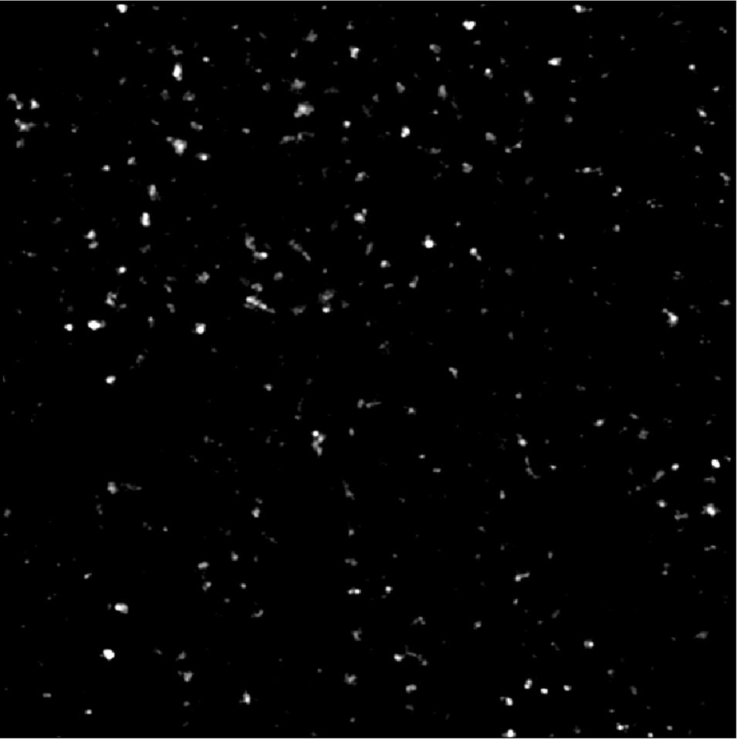
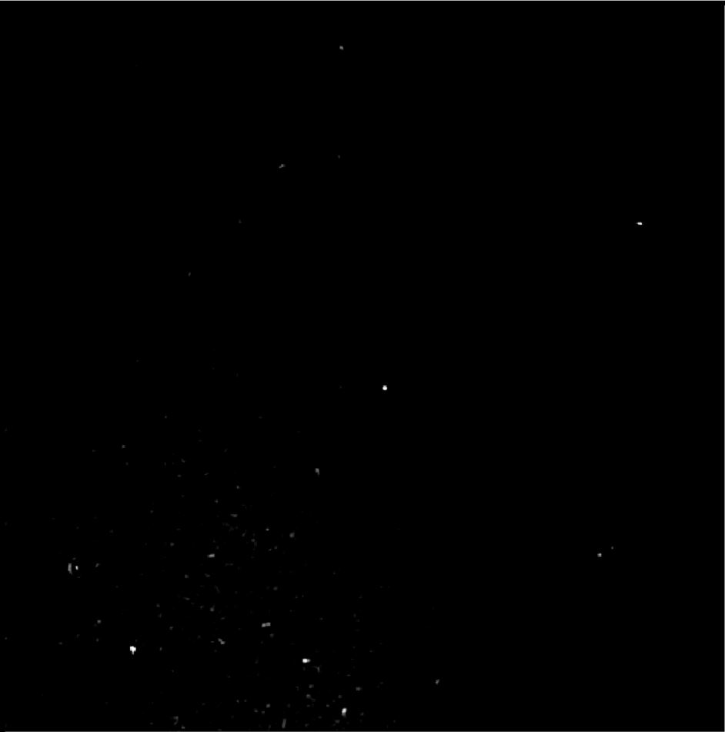
Image of Detected Particles via PANORAMA (11)(Prediction: Healthy)
Time: 60 min
Count: 369 (Ex: 231; Large: 138)
Time: 60 min wash
Count: 34
Based On Count: Before wash count higher than Healthy CI (64-172)
After wash slightly higher than Healthy CI (7-28)
Note: 0% response to miRNA-21
Scale Bar: 10 µm

Slide 13
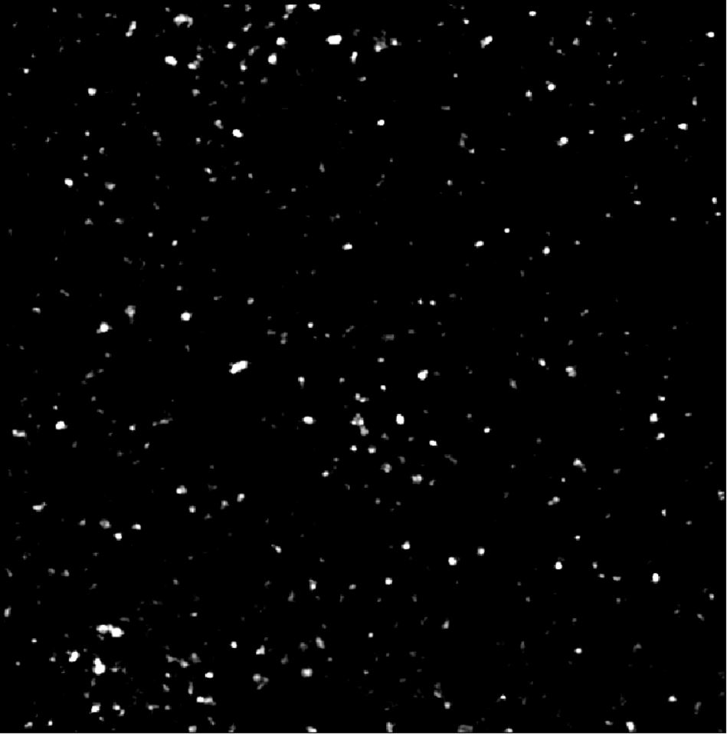
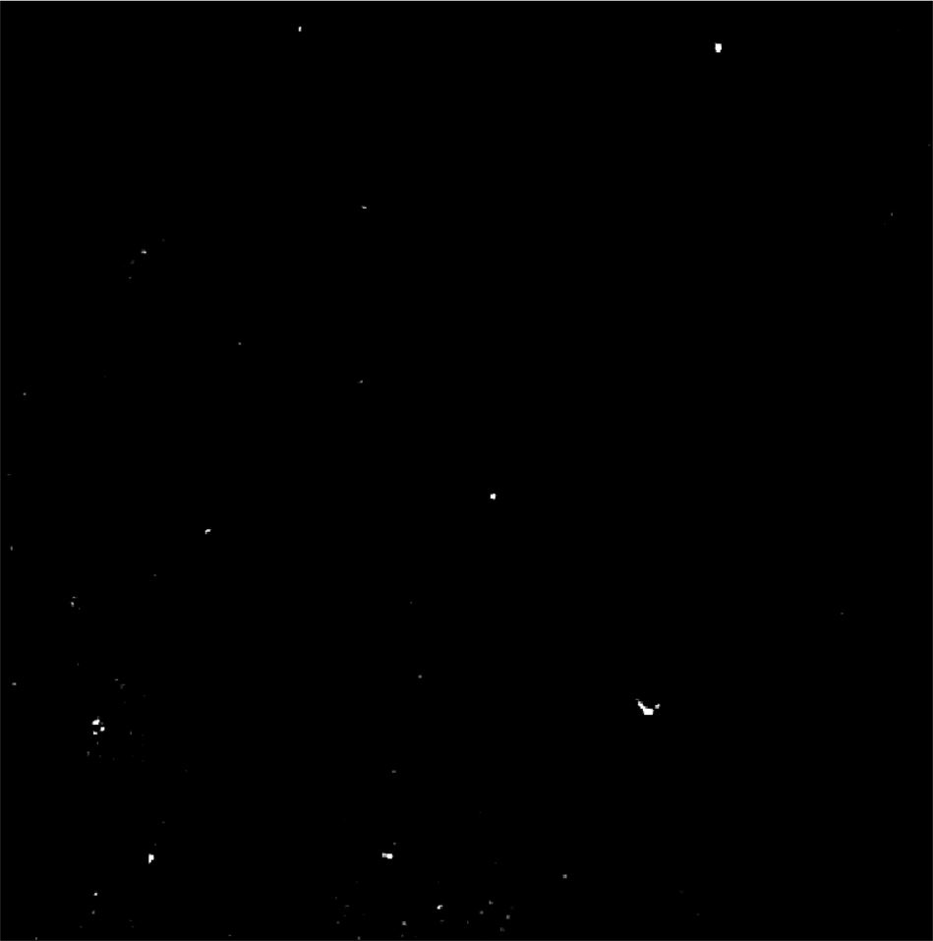
Image of Detected Particles via PANORAMA (12)(Prediction: Healthy)
Time: 60 min
Count: 398 (Ex: 281; Large: 117)
Time: 60 min wash
Count: 35
Based On Count: Before wash count higher than Healthy CI (64-172)
After wash slightly higher than Healthy CI (7-28)
Note: 0% response to miRNA-21
Scale Bar: 10 µm

Slide 14
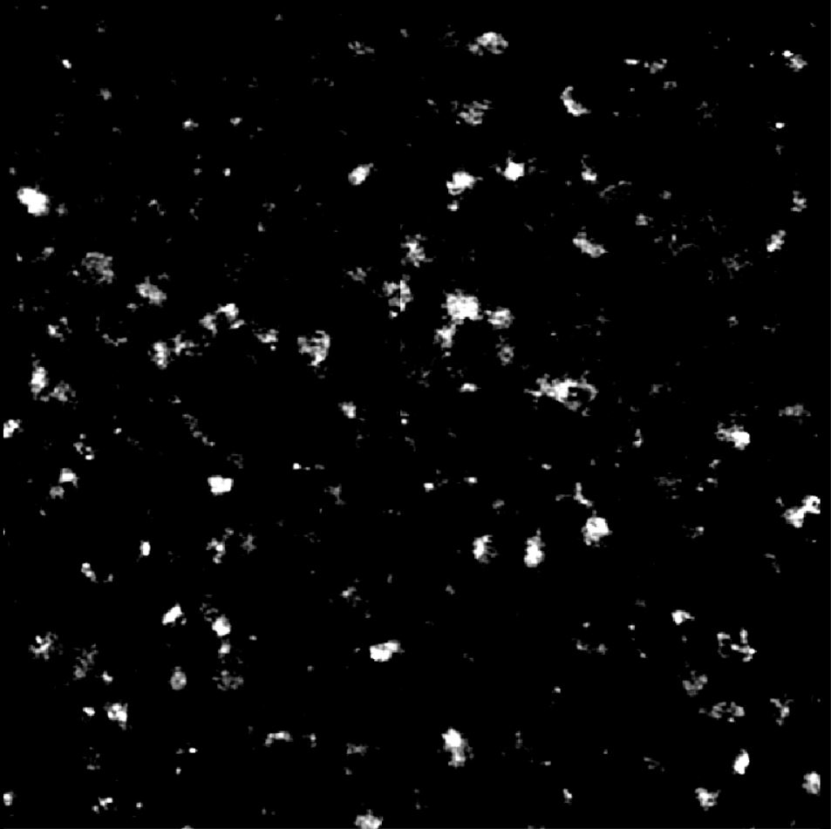
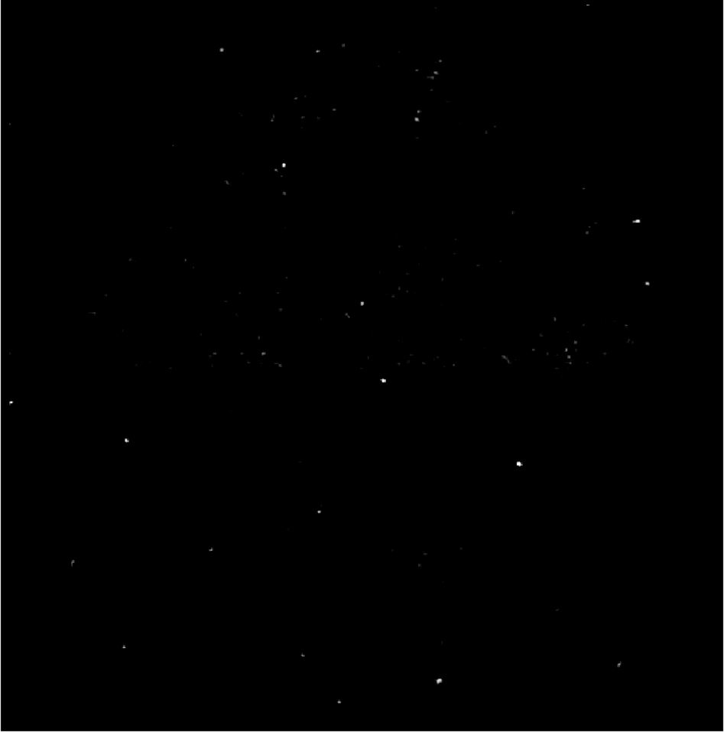
Image of Detected Particles via PANORAMA (13) (Prediction: Healthy (12%))
Time: 60 min
Count: 352 (Ex: 266; Large: 86)
Time: 60 min wash
Count: 81
Based On Count: Before wash count higher than Healthy CI (64-172)
After wash Higher than Healthy CI (7-28)but lower than Cancer stage I (151-370)
Note: 0% response to miRNA-21
Scale Bar: 10 µm

Slide 15
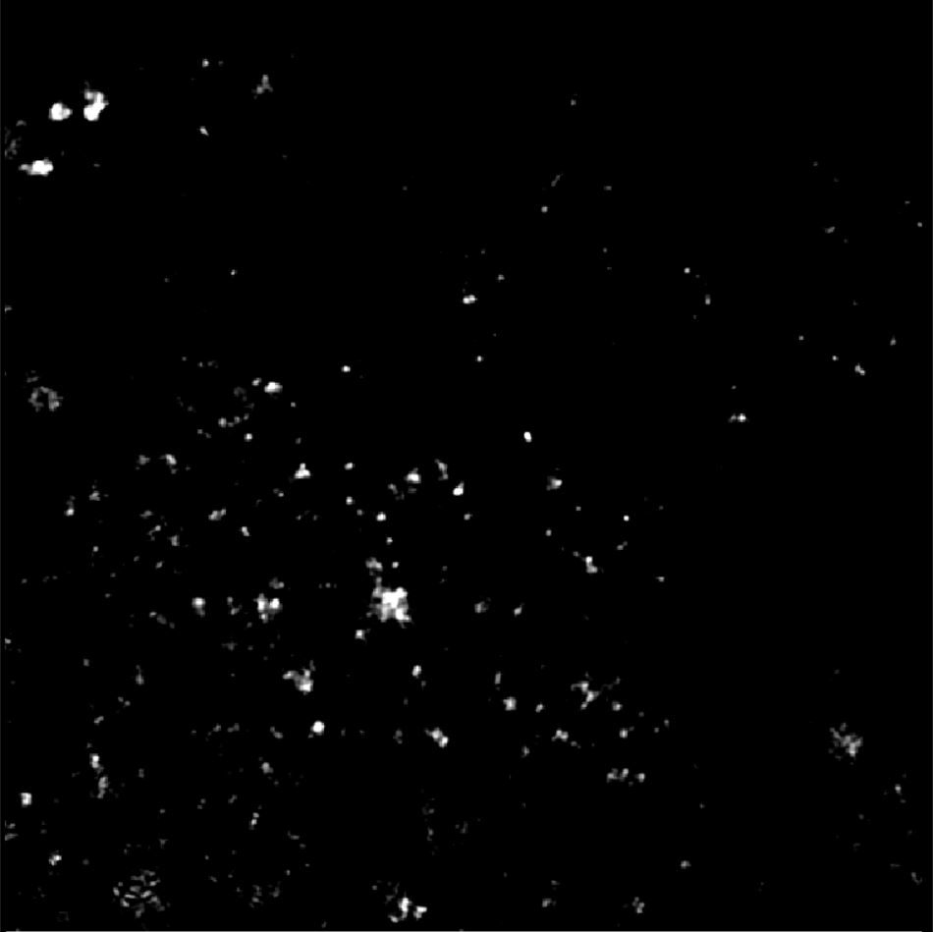

Image of Detected Particles via PANORAMA (14) (Prediction: Healthy)
Time: 60 min
Count: 148 (Ex: 93; Large: 55)
Time: 60 min wash
Count: 13
Based On Count: Before wash count matches Healthy CI (64-172)
After wash matches Healthy CI (7-28)
Note: 0% response to miRNA-21
Scale Bar: 10 µm

Slide 16
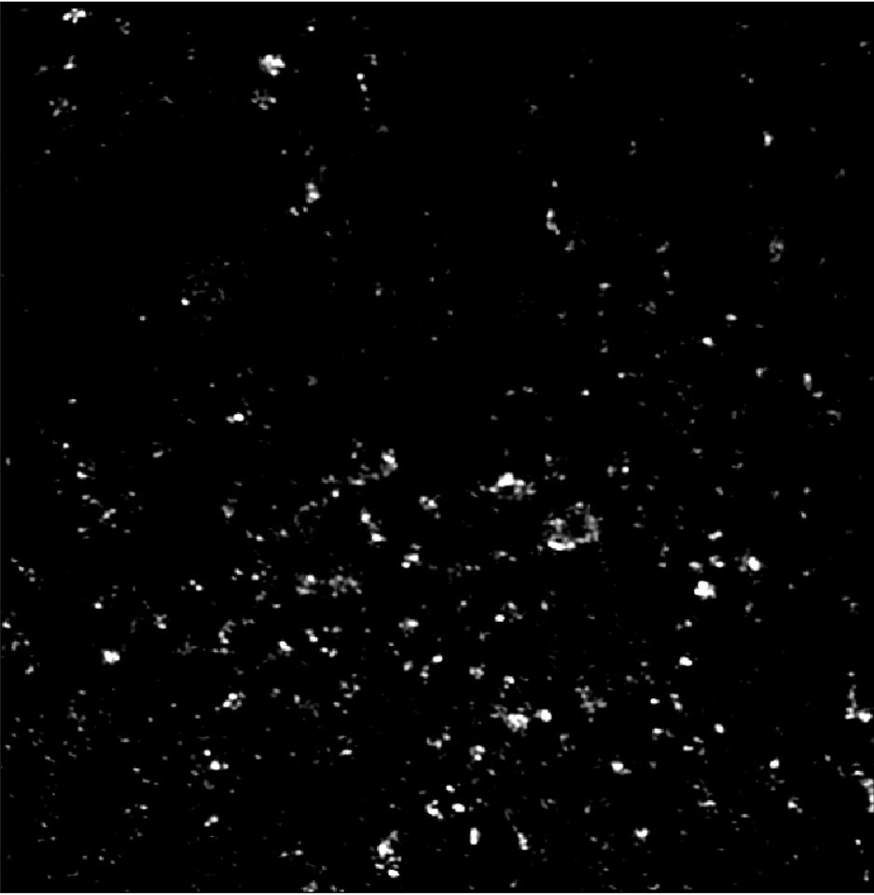

Image of Detected Particles via PANORAMA (15)(Prediction: Cancer)
Time: 60 min
Count: 428 (Ex: 290; Large: 138)
Time: 60 min wash
Count: 85
Based On Count: Before wash count lower than CI of stage 1 (950-1558)
After wash count lower than CI for stage 1 (151-370)
Note: 11.5% % response to miRNA-21
Scale Bar: 10 µm

Slide 17
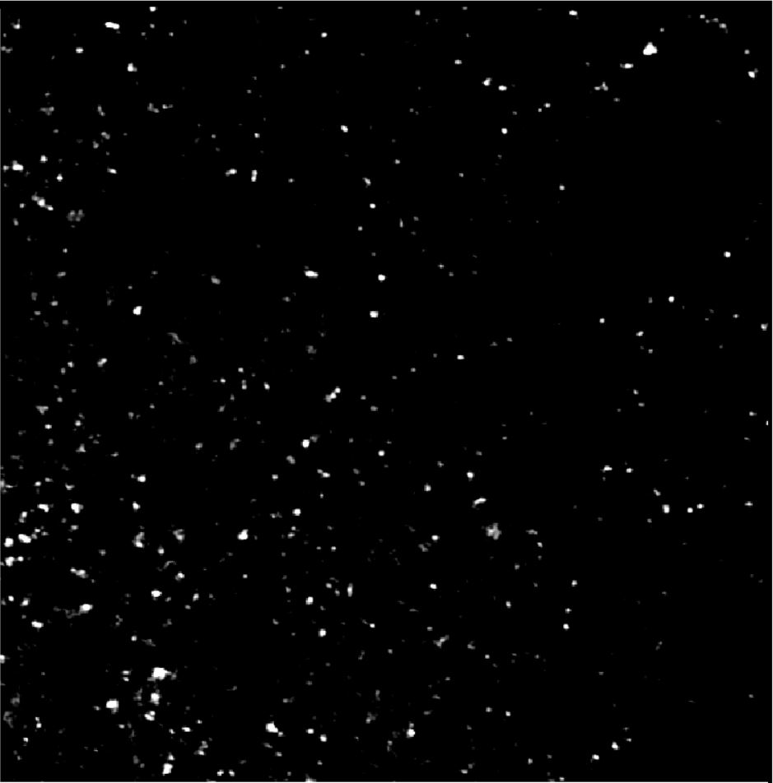

Image of Detected Particles via PANORAMA (16) (Prediction: Healthy)
Time: 60 min
Count: 264 (Ex: 186; Large: 78)
Time: 60 min wash
Count: 21
Based On Count: Before wash count matches Healthy CI (64-172)
After wash matches Healthy CI (7-28)
Note: 0% response to miRNA-21
Scale Bar: 10 µm

Slide 18
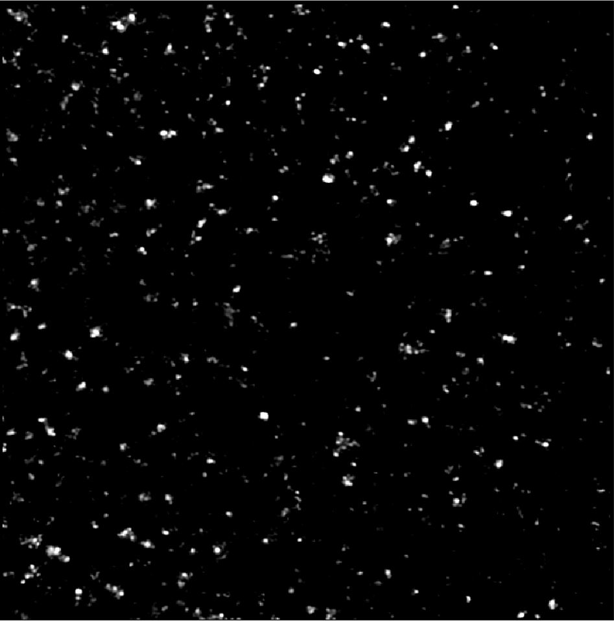

Image of Detected Particles via PANORAMA (17)(Prediction: Healthy)
Time: 60 min
Count: 381 (Ex: 238; Large: 143)
Time: 60 min wash
Count: 23
Based On Count: Before wash count matches Healthy CI (64-172)
After wash matches Healthy CI (7-28)
Note: 0% response to miRNA-21
Scale Bar: 10 µm

Slide 19
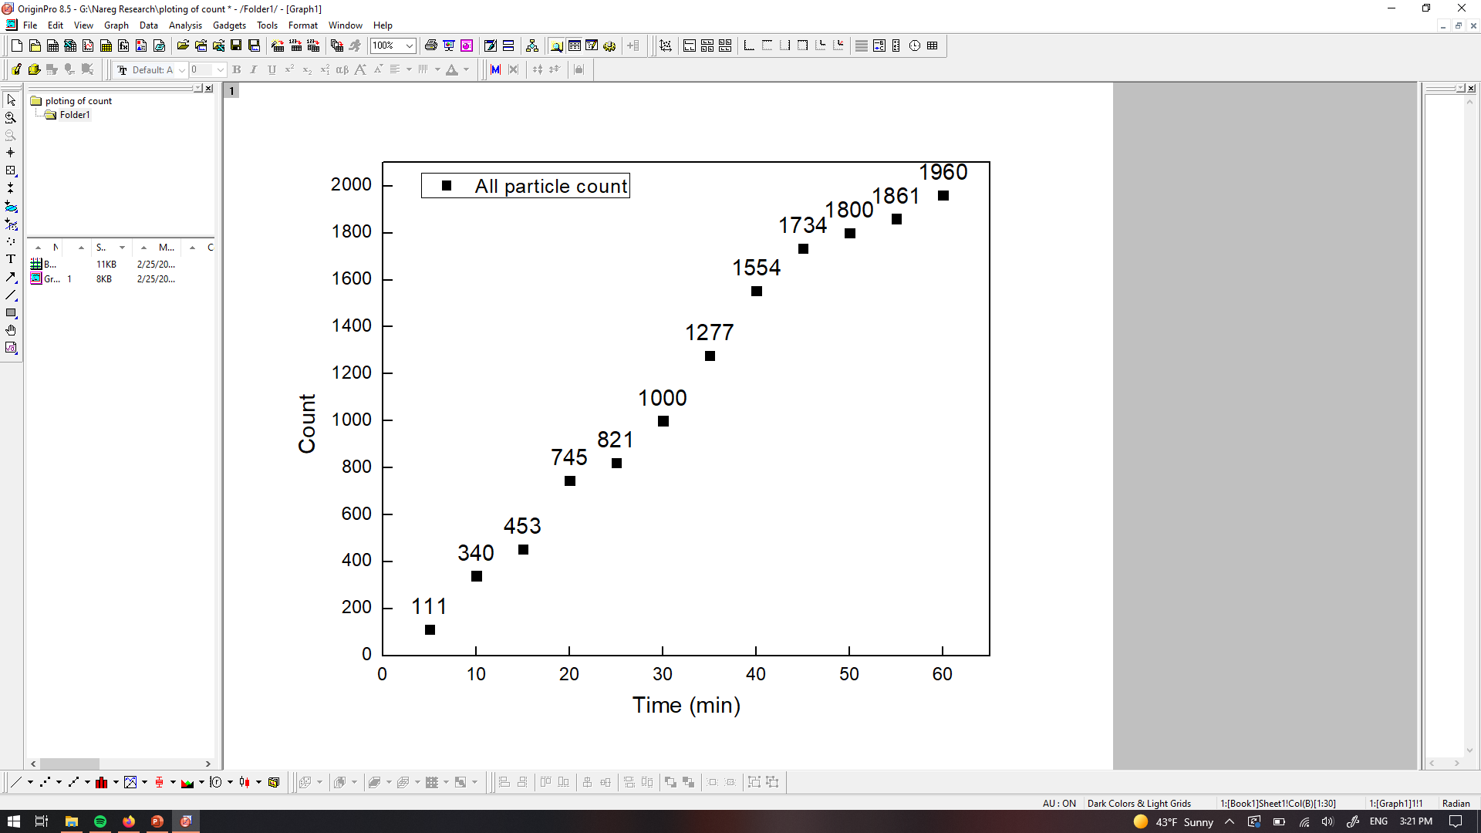

PANORAMA of Plasma Sample 18 (Prediction: Cancer)
Time: 60 min
Count: 1960 (Ex: 1623; Large: 337)
Time: 60 min wash
Count: 221
Based On Count: Before wash count Exceeds CI of stage 1 (950-1558)
After wash count matches CI for stage 1 (151-370)
Note: 0 % response to miRNA-21
Scale bar: 10 µm

Slide 20
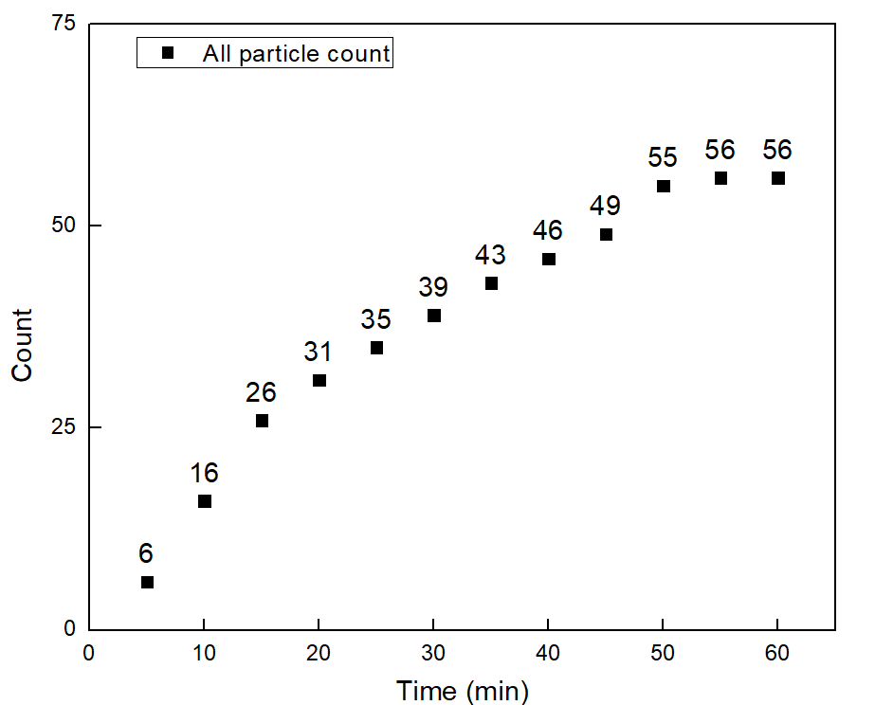


PANORAMA of Plasma Sample 19 (Prediction: Healthy)
Time: 60 min
Count: 56 (Ex: 49; Large: 7)
Time: 60 min wash
Count: 22
Based On Count: Before wash count matches Healthy (64-172)
After wash count matches CI Healthy (7-28)
Note: 0 % response to miRNA-21
Scale bar: 10 µm

Slide 21
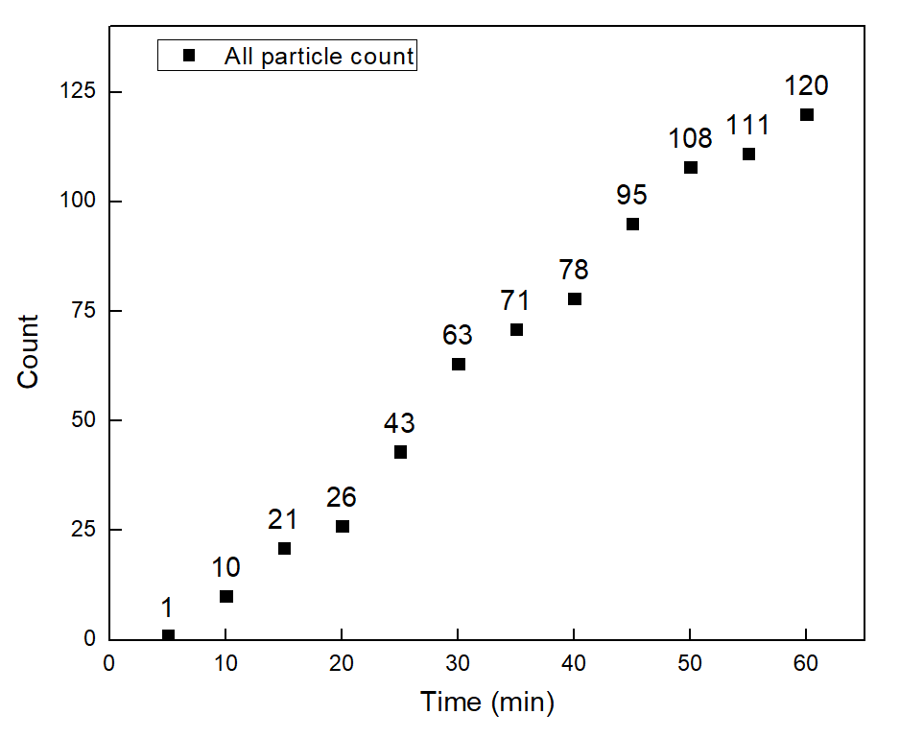

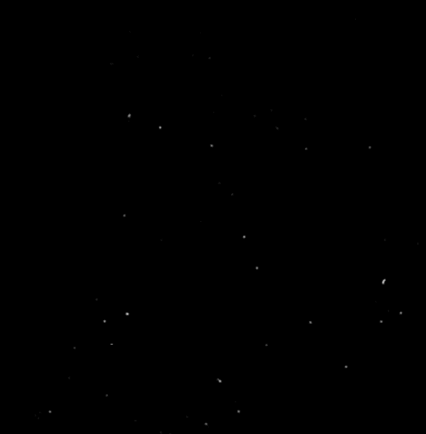
PANORAMA of Plasma Sample 20 (Prediction: Healthy)
Time: 60 min
Count: 120 (Ex: 97; Large: 23)
Time: 60 min wash
Count: 22
Based On Count: Before wash count matches Healthy (64-172)
After wash count matches CI Healthy (7-28)
Note: 0 % response to miRNA-21
Scale bar: 10 µm

Slide 22



PANORAMA of Plasma Sample 21 (Prediction: Healthy)
Time: 60 min
Count: 106 (Ex: 96; Large: 10)
Time: 60 min wash
Count: 31
Based On Count: Before wash count matches Healthy (64-172)
After wash count matches CI Healthy (7-28)
Note: 0 % response to miRNA-21
Scale bar: 10 µm

Slide 23
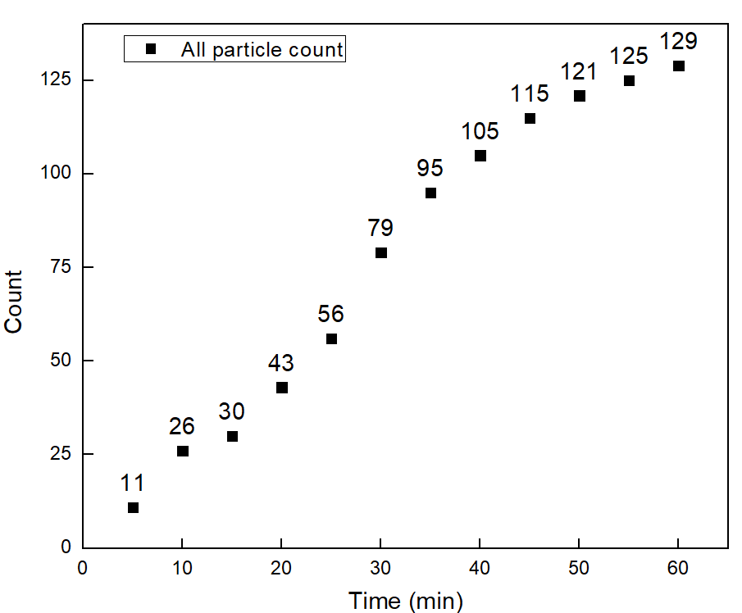


PANORAMA of Plasma Sample 22 (Prediction: Healthy)
Time: 60 min
Count: 129 (Ex: 112; Large: 17)
Time: 60 min wash
Count: 26
Based On Count: Before wash count matches Healthy (64-172)
After wash count matches CI Healthy (7-28)
Note: 0 % response to miRNA-21
Scale bar: 10 µm

Slide 24

PANORAMA of Plasma Sample 23 (Prediction: Healthy)
Time: 60 min
Count: 226 (Ex: 184; Large: 42)
Time: 60 min wash
Count: 27
Based On Count: Before wash count slightly higher CI Healthy (64-172)
After wash count matches CI Healthy (7-28)
Note: 0 % response to miRNA-21
Scale bar: 10 µm

Slide 25
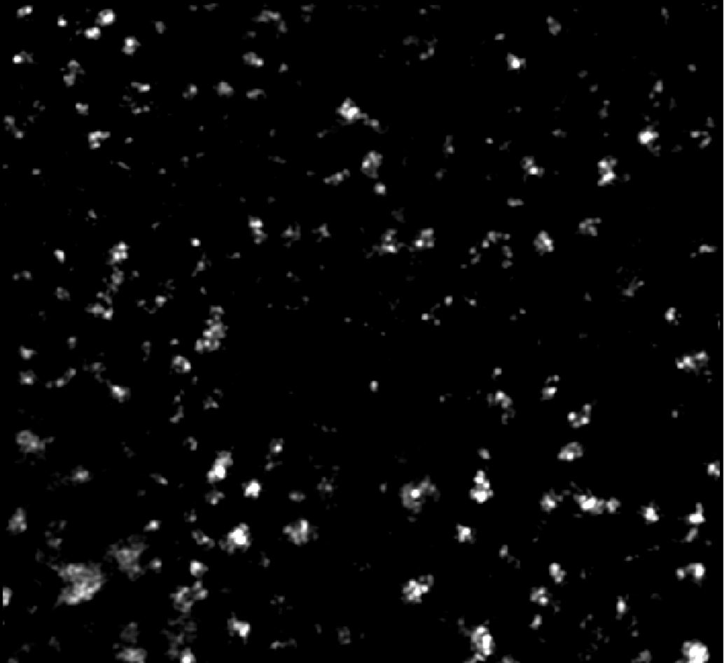
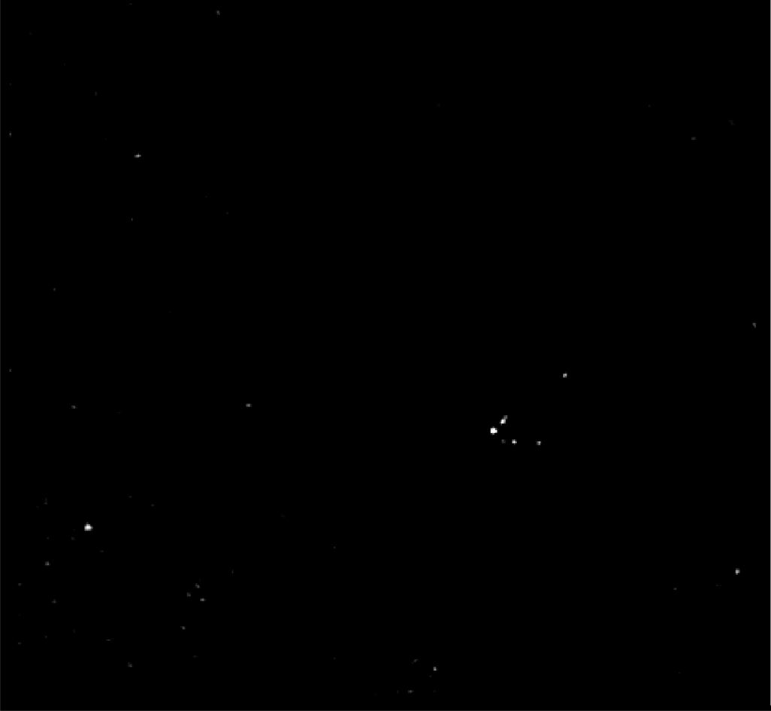
Image of Detected Particles via PANORAMA (24)(Prediction: Healthy)
Time: 60 min
Count: 249 (Ex: 139; Large: 110)
Time: 60 min wash
Count: 31
Based On Count: Before wash count higher than Healthy (64-172)
After wash count matches CI Healthy (7-28)
Note: 0 % response to miRNA-21
Scale Bar: 10 µm

Slide 26
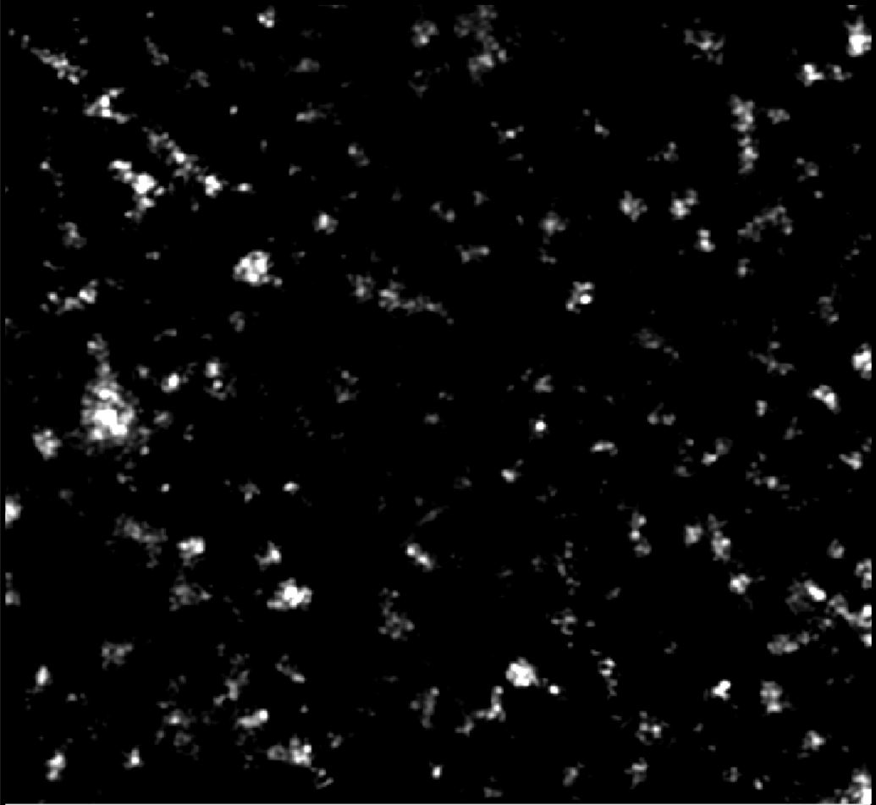

Image of Detected Particles via PANORAMA (25)(Prediction: Cancer(50%))
Time: 60 min
Count: 320 (Ex: 235; Large: 85)
Time: 60 min wash
Count: 120
Based On Count: Before wash count lower than CI of stage 1 (950-1558)
After wash count lower than CI for stage 1 (151-370)
Note: 0 % response to miRNA-21
Scale Bar: 10 µm

Slide 27
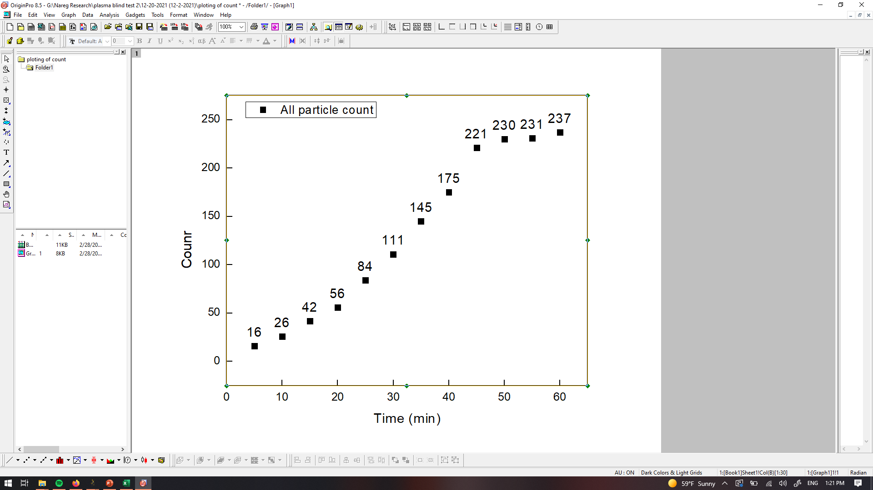
PANORAMA of Plasma Sample 26 (Prediction: Healthy(45%))
Time: 60 min
Count: 237 (Ex:146; Large: 91)
Time: 60 min wash
Count: 63
Based On Count: Before wash count slightly higher than CI Healthy (64-172)
After wash count slightly higher than CI Healthy (7-28); less than cutoff 75.
Note: 0 % response to miRNA-21
Scale bar: 10 µm

Slide 28
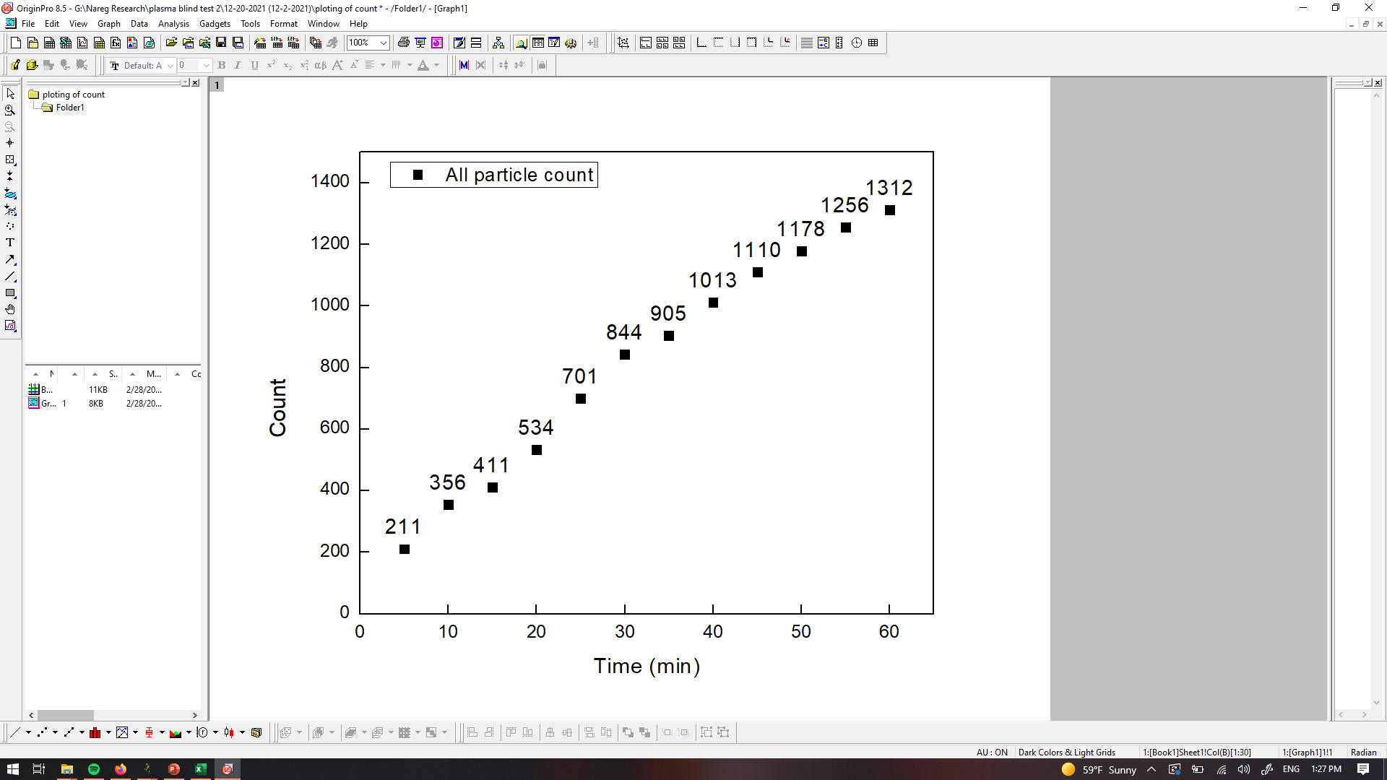
PANORAMA of Plasma Sample 27 (Prediction: Cancer)
Time: 60 min
Count: 1312 (Ex:1074; Large: 238)
Time: 60 min wash
Count: 202
Based On Count: Before wash count matches CI of stage 1 (950-1558)
After wash count matches CI for stage 1 (151-370)
Note: 0 % response to miRNA-21
Scale bar: 10 µm

Slide 29
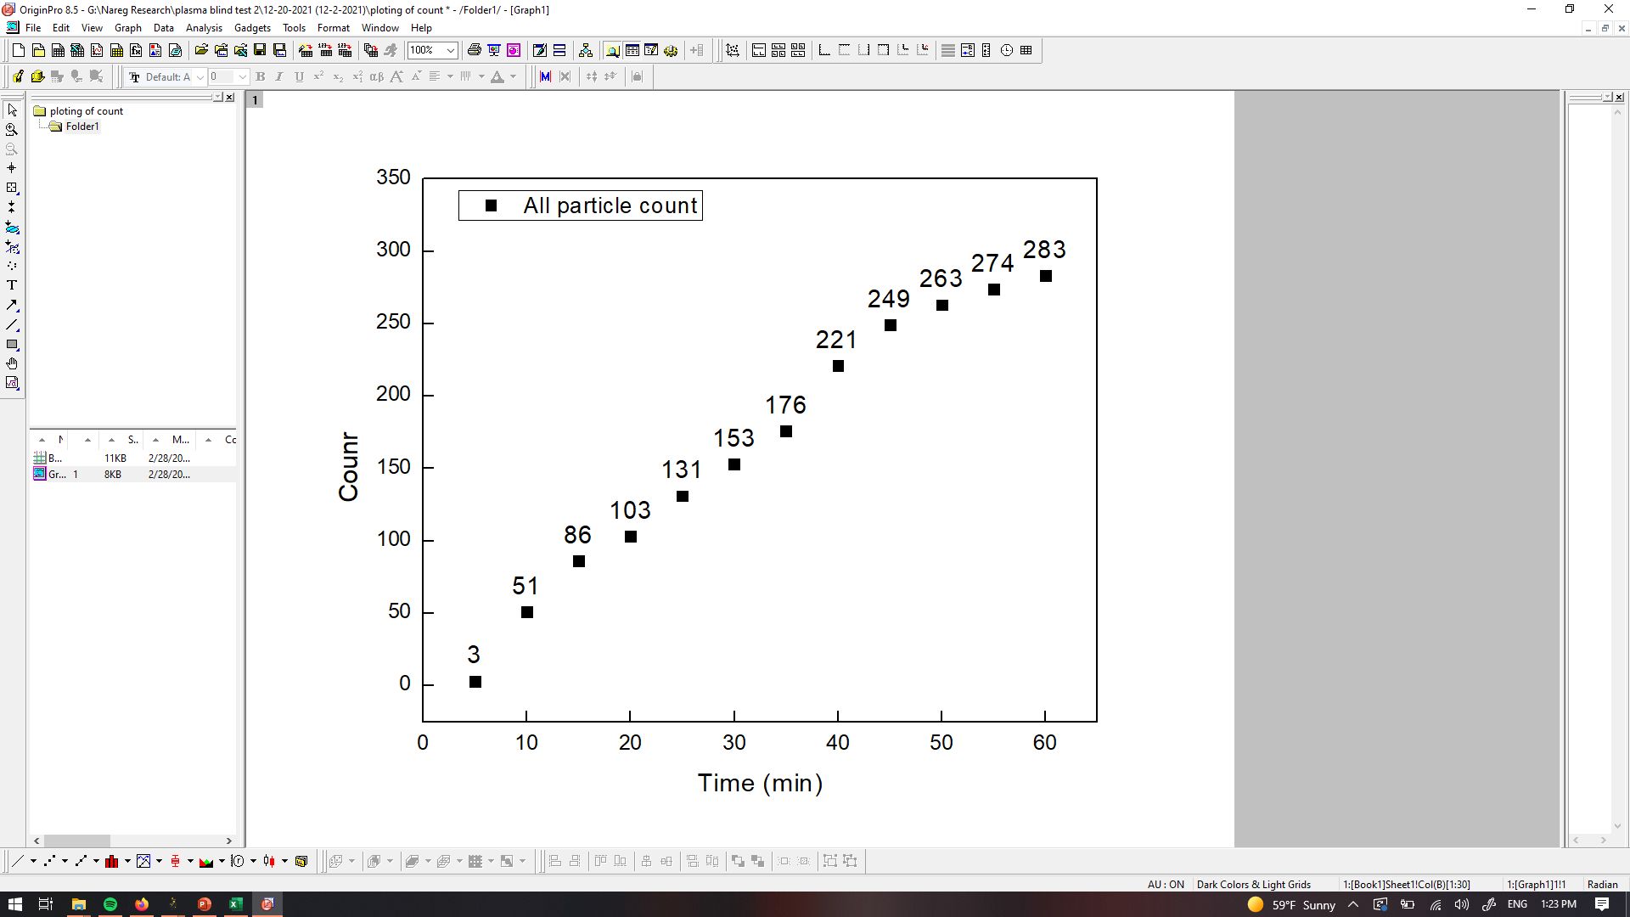
PANORAMA of Plasma Sample 28 (Prediction: Healthy(75%))
Time: 60 min
Count: 283 (Ex: 207; Large: 76)
Time: 60 min wash
Count: 43
Based On Count: Before wash count slightly higher than CI Healthy (64-172)
After wash count slightly higher than CI Healthy (7-28); less than cutoff 75.
Note: 0 % response to miRNA-21
Scale bar: 10 µm

Slide 30
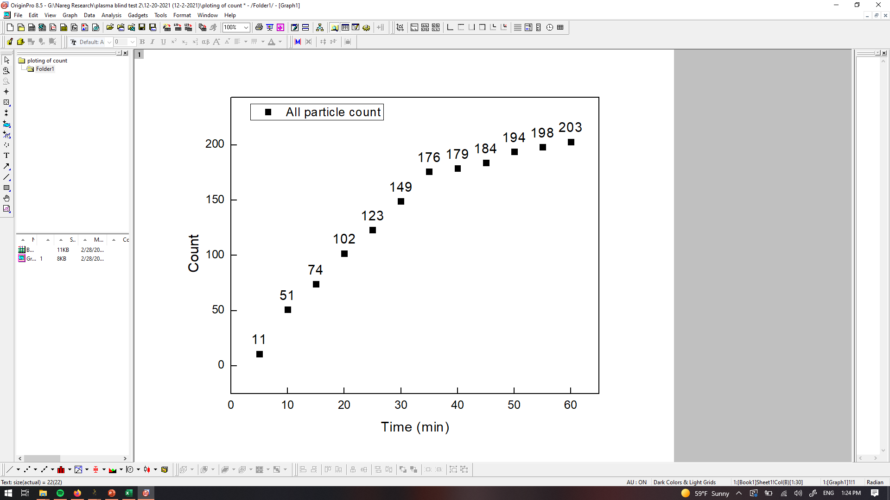
PANORAMA of Plasma Sample 29 (Prediction: Healthy)
Time: 60 min
Count: 203 (Ex: 171; Large: 32)
Time: 60 min wash
Count: 13
Based On Count: Before wash count slightly higher than CI Healthy (64-172)
After wash count matches CI Healthy (7-28).
Note: 0 % response to miRNA-21
Scale bar: 10 µm

Slide 31
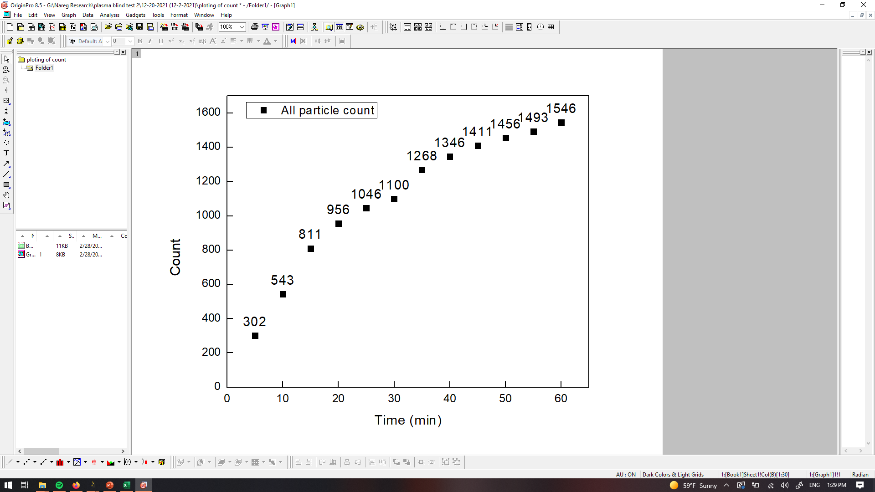

PANORAMA of Plasma Sample 30 (Prediction: Cancer)
Time: 60 min
Count: 1546 (Ex: 1261; Large: 285)
Time: 60 min wash
Count: 313
Based On Count: Before wash count matches CI of stage 1 (950-1558)
After wash count matches CI CI for stage 1 (151-370)
Note: 0 % response to miRNA-21
Scale bar: 10 µm

Slide 32

PANORAMA of Plasma Sample 31 (Prediction: Healthy)
Time: 60 min
Count: 202 (Ex: 171; Large: 32)
Time: 60 min wash
Count: 26
Based On Count: Before wash count slightly higher than CI Healthy (64-172)
After wash count matches CI Healthy (7-28).
Note: 0 % response to miRNA-21
Scale bar: 10 µm

Slide 33
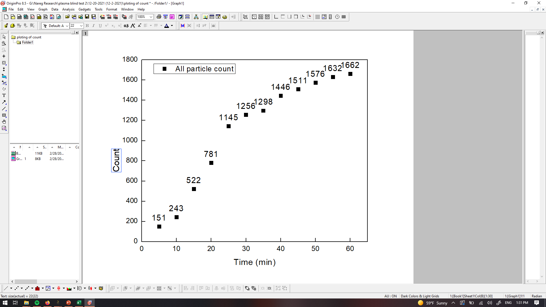

PANORAMA of Plasma Sample 32 (Prediction: Cancer)
Time: 60 min
Count: 1662 (Ex: 1399; Large: 263)
Time: 60 min wash
Count: 284
Based On Count: Before wash count higher than CI of stage 1 (950-1558)
After wash count matches CI for stage 1 (151-370)
Note: 0 % response to miRNA-21
Scale bar: 10 µm

Slide 34
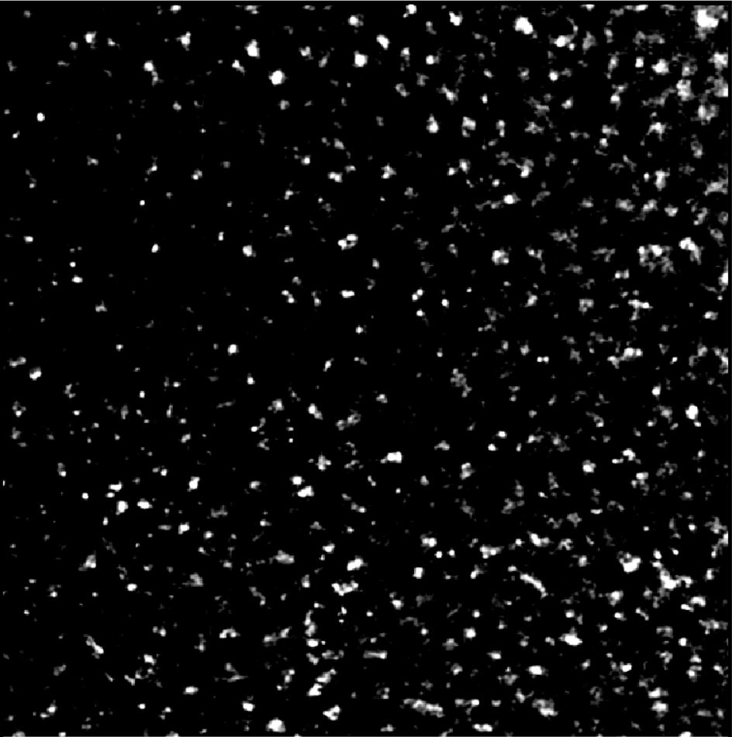
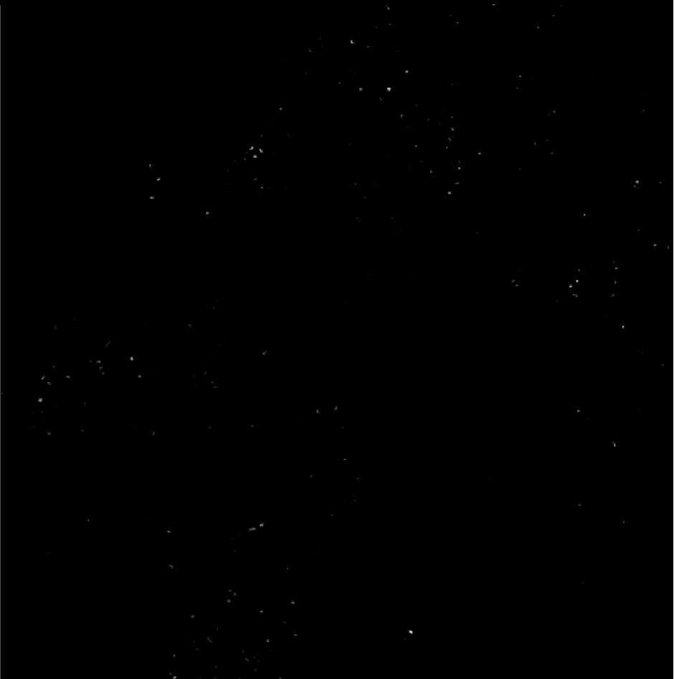
Image of Detected Particles via PANORAMA (33)
Time: 60 min
Count: 510 (Ex: 406; Large: 104)
Time: 60 min wash
Count: 105
Note: 0 % response to miRNA-21
Prediction: Cancer (25%)
Note: Before wash count lower CI of stage 1 (950-1558)
After wash count lower end CI for stage 1 (151-370)
Scale Bar: 10 µm

Slide 35
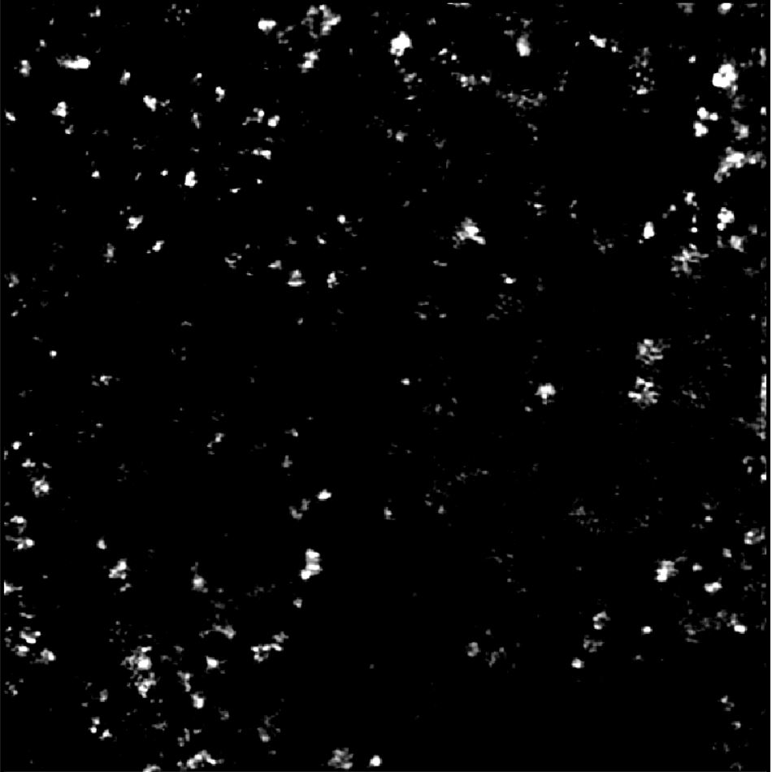

Image of Detected Particles via PANORAMA (34)
Time: 60 min
Count: 298 (Ex: 241; Large: 57)
Time: 60 min wash
Count: 93
Note: 0 % response to miRNA-21
Prediction: Cancer (5%)
Note: Before wash count lower than CI of stage 1 (950-1558)
After wash count lower end CI for stage 1 (151-370)
Scale Bar: 10 µm

Slide 36
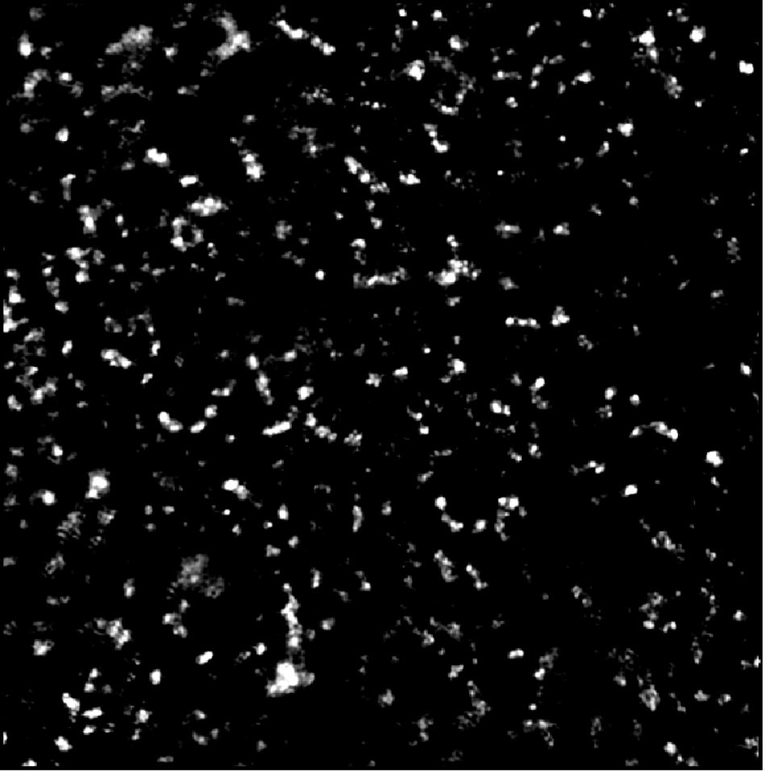

Image of Detected Particles via PANORAMA (35)
Time: 60 min
Count: 526 (Ex: 396; Large: 130)
Time: 60 min wash
Count: 99
Note: 0 % response to miRNA-21
Prediction: Cancer (15%)
Note: Before wash count lower than CI of lung stage 1 (950-1558)
After wash count lower than CI for lung stage 1 (151-370)
Scale Bar: 10 µm

Slide 37
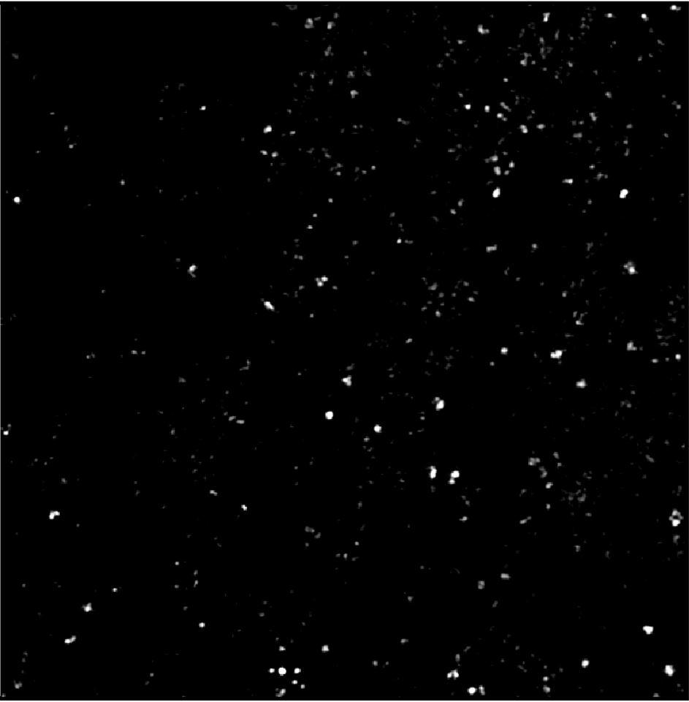
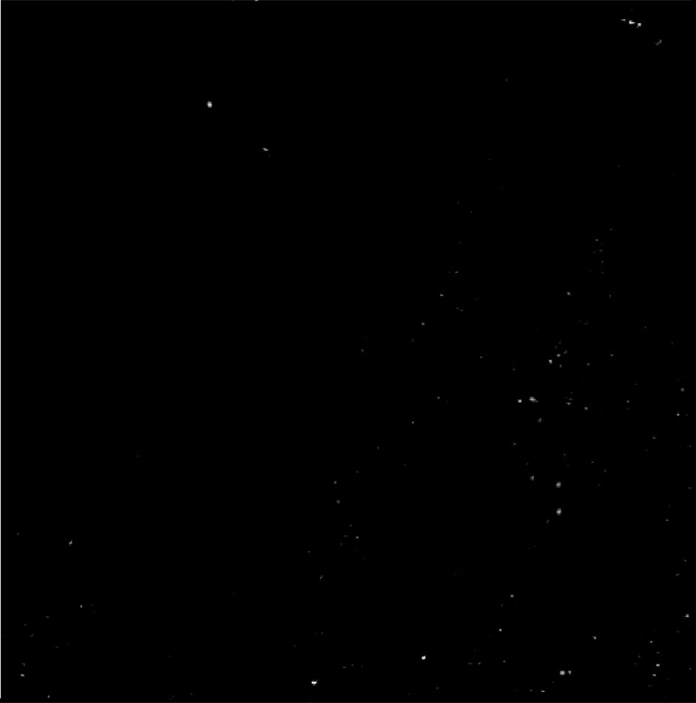
Image of Detected Particles via PANORAMA (36/51)
Time: 60 min
Count: 424 (Ex: 359; Large: 65)
Time: 60 min wash
Count: 98
Based On Count: Before wash count between the CI of stage 1 (950-1558) and Healthy (64-172)
After wash is lower than the CI for stage 1 (151-370)
Note: 0 % response to miRNA-21
Look cancerous
Scale Bar: 10 µm

Slide 38
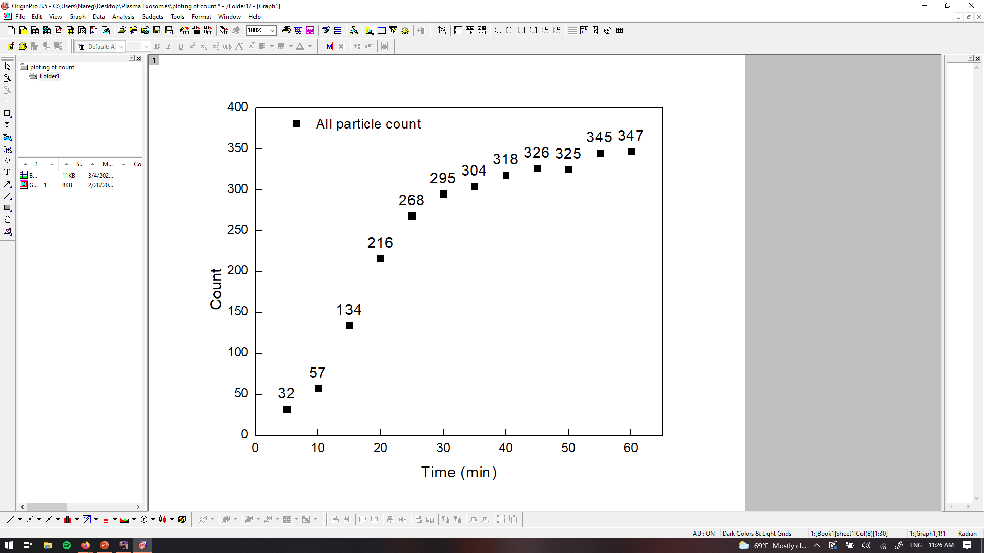
PANORAMA of Plasma Sample 37 (Prediction: (Healthy 27%))
Time: 60 min
Count: 347 (Ex: 218; Large: 129)
Time: 60 min wash
Count: 74
Based On Count: Before wash count higher than CI Healthy (64-172)
After wash count significantly higher than CI Healthy (7-28).
Note: 0 % response to miRNA-21
Scale bar: 10 µm

Slide 39
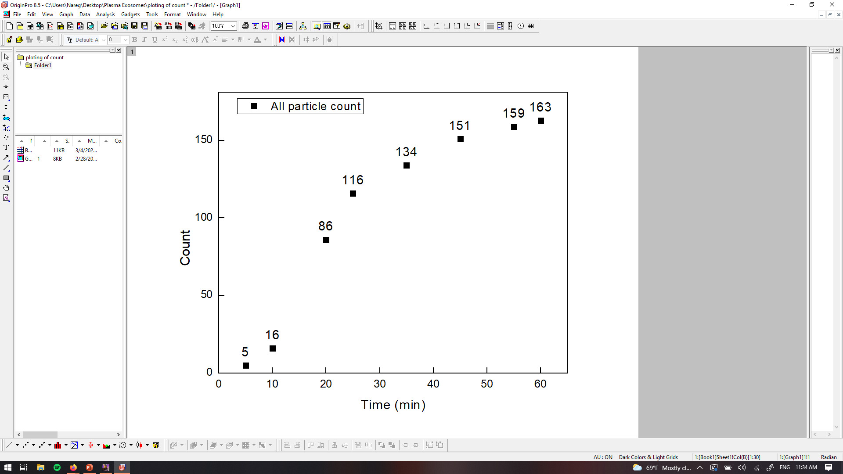
PANORAMA of Plasma Sample 38 (Prediction: Healthy)
Time: 60 min
Count: 163 (Ex: 137; Large: 26)
Time: 60 min wash
Count: 5
Based On Count: Before wash count higher than CI Healthy (64-172)
After wash count lower than CI Healthy (7-28).
Note: 0 % response to miRNA-21
Scale bar: 10 µm

Slide 40

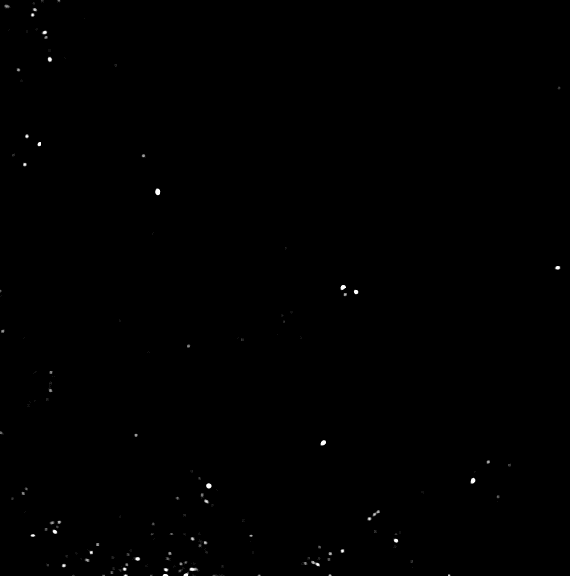
PANORAMA of Plasma Sample 39 (Prediction: Healthy)
Time: 60 min
Count: 95 (Ex: 85; Large: 15)
Time: 60 min wash
Count: 26
Based On Count: Before wash count higher than CI Healthy (64-172)
After wash count matches CI Healthy (7-28).
Note: 0 % response to miRNA-21
Scale bar: 10 µm

Slide 41
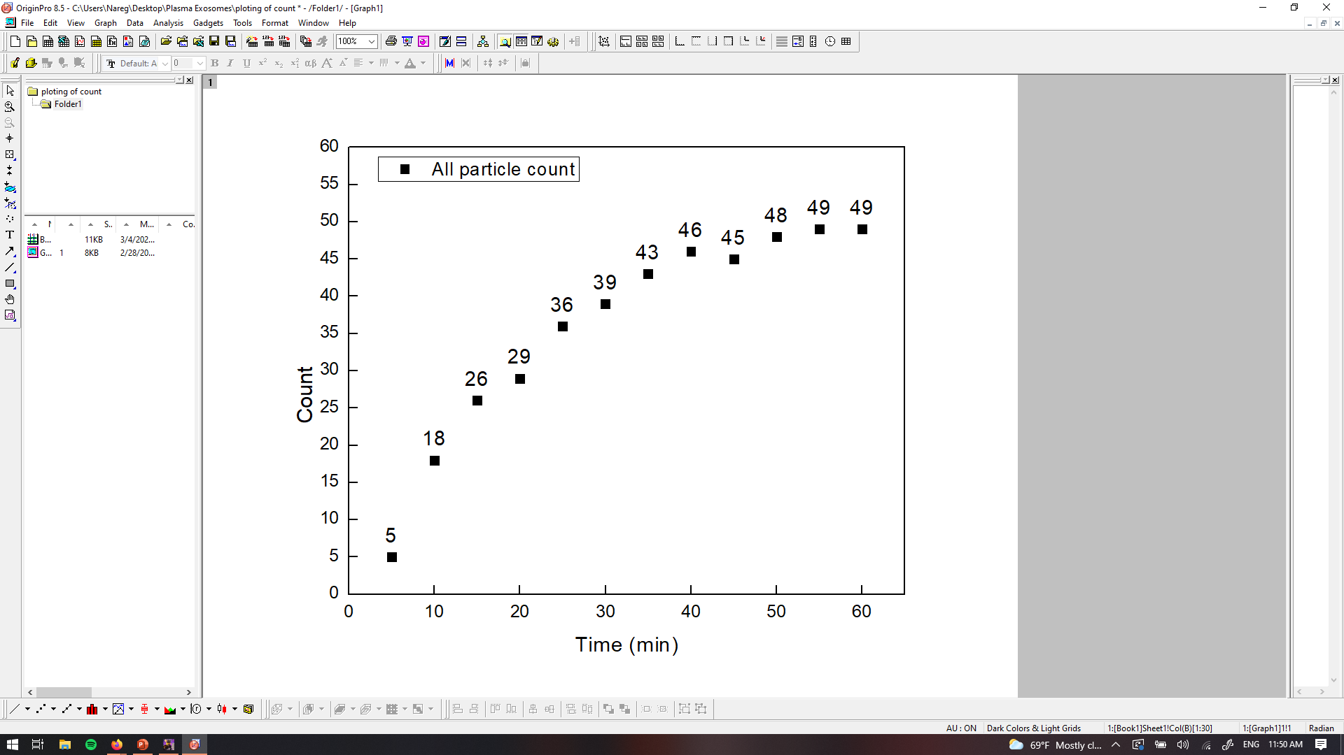
PANORAMA of Plasma Sample 40 (Prediction: Healthy)
Time: 60 min
Count: 49 (Ex: 39; Large: 10)
Time: 60 min wash
Count: 4
Based On Count: Before wash count higher than CI Healthy (64-172)
After wash count lower than CI Healthy (7-28).
Note: 0 % response to miRNA-21
Scale bar: 10 µm

Slide 42
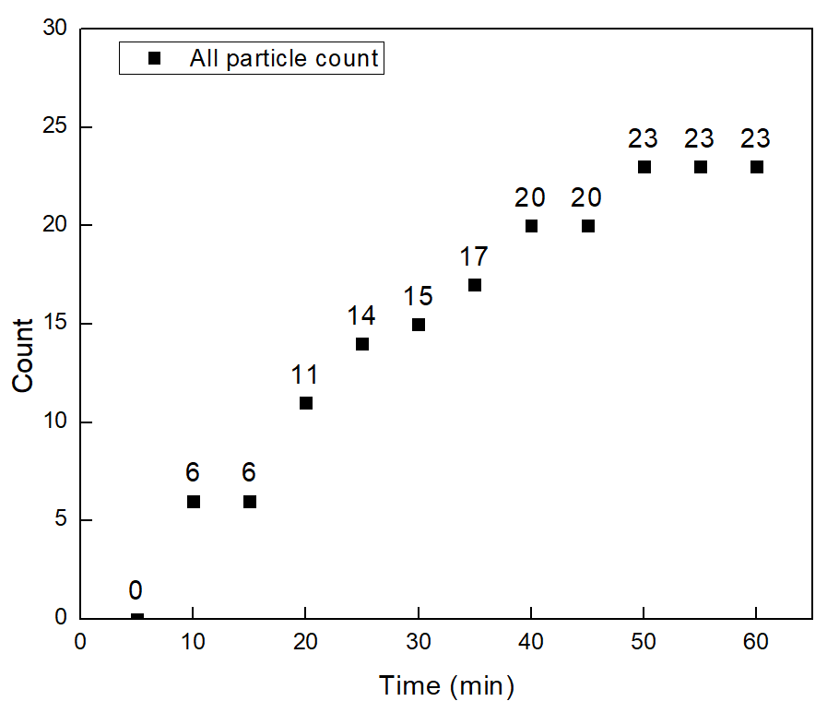


PANORAMA of Plasma Sample 41 (Prediction: Healthy)
Time: 60 min
Count: 23 (Ex: 23; Large: 0)
Time: 60 min wash
Count: 5
Based On Count: Before wash count higher than CI Healthy (64-172)
After wash count lower than CI Healthy (7-28).
Note: 0 % response to miRNA-21
Scale bar: 10 µm

Slide 43
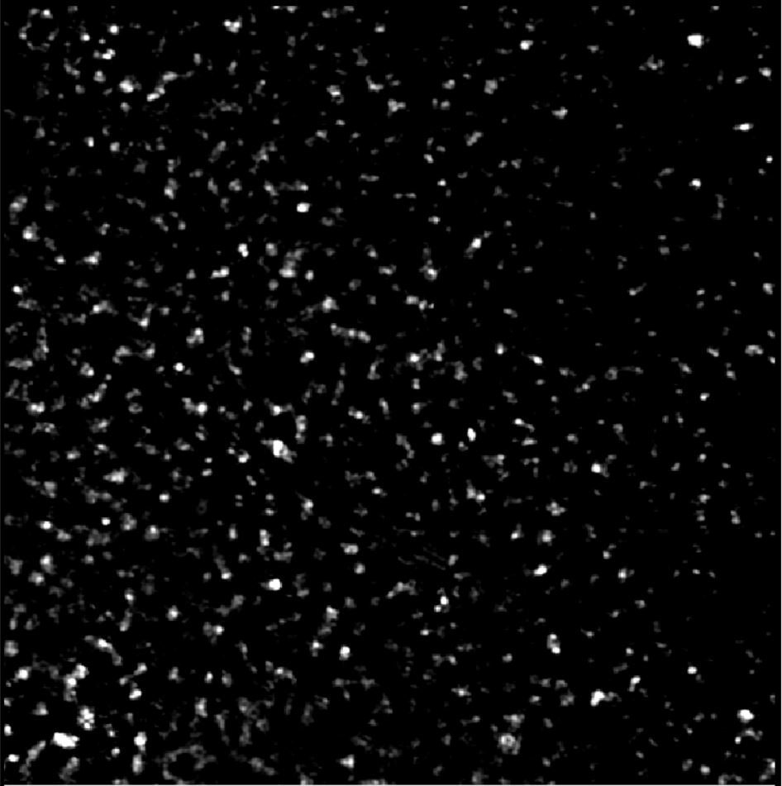

Image of Detected Particles via PANORAMA (42)
Time: 60 min
Count: 753 (Ex: 626; Large: 127)
Time: 60 min wash
Count: 123
Note: 0 % response to miRNA-21
Prediction: Cancer (55%)
Note: Before wash count slightly lower than CI of 1 (950-1558)
After wash count lower end CI for stage 3 (151-370)
Scale Bar: 10 µm

Slide 44
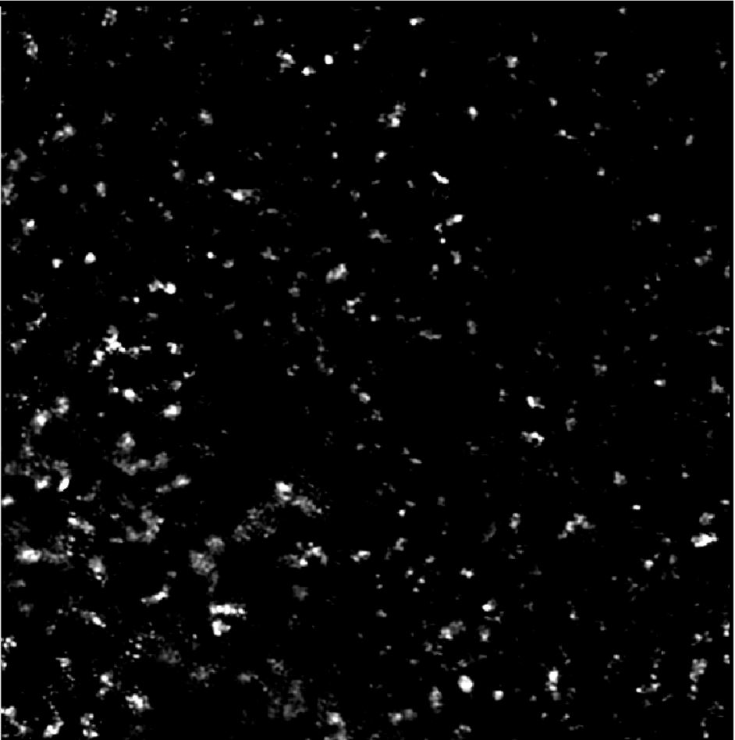

Image of Detected Particles via PANORAMA (43)
Time: 60 min
Count: 397 (Ex: 308; Large: 89)
Time: 60 min wash
Count: 20
Note: Before wash count lower than CI of stage 1 (950-1558)
After wash count lower than CI for stage 1 (151-370)
Note: 0 % response to miRNA-21
Prediction: Healthy
Scale Bar: 10 µm

Slide 45


PANORAMA of Plasma Sample 44 (Prediction: Healthy (77%))
Time: 60 min
Count: 216 (Ex: 204; Large: 12)
Time: 60 min wash
Count: 44
Based On Count: Before wash count higher than CI Healthy (64-172)
After wash count slightly higher than CI Healthy (7-28).
Note: 0 % response to miRNA-21
Scale bar: 10 µm

Slide 46



PANORAMA of Plasma Sample 45 (Prediction: Cancer)
Time: 60 min
Count: 2191 (Ex: 1984; Large: 207)
Time: 60 min wash
Count: 215
Based On Count: Before wash count exceeds CI of stage 1 (950-1558)
After wash count matches CI for stage 1 (151-370)
Note: 0 % response to miRNA-21
Scale bar: 10 µm

Slide 47

PANORAMA of Plasma Sample 46 (Prediction: Healthy)
Time: 60 min
Count: 37 (Ex: 31; Large: 6)
Time: 60 min wash
Count: 11
Based On Count: Before wash count higher than CI Healthy (64-172)
After wash count slightly higher than CI Healthy (7-28).
Note: 0 % response to miRNA-21
Scale bar: 10 µm

Slide 48


PANORAMA of Plasma Sample 47 (Prediction: Cancer)
Time: 60 min
Count: 1340 (Ex: 1112; Large: 228)
Time: 60 min wash
Count: 266
Based On Count: Before wash count matches CI stage 1 lung cancer (950-1558)
After wash count matches CI stage 1 lung cancer (151-370).
Note: 0 % response to miRNA-21
Scale bar: 10 µm

Slide 49

PANORAMA of Plasma Sample 48 (Prediction: Healthy)
Time: 60 min
Count: 327 (Ex: 255; Large: 72)
Time: 60 min wash
Count: 19
Based On Count: Before wash count higher than CI Healthy (64-172)
After wash count mathes CI Healthy (7-28).
Note: 0 % response to miRNA-21
Scale bar: 10 µm

Slide 50


PANORAMA of Plasma Sample 49 (Prediction: Healthy (38%))
Time: 60 min
Count: 742 (Ex: 586; Large: 156)
Time: 60 min wash
Count: 67
Based On Count: Before wash count higher than CI Healthy (64-172)
After wash count lower than CI Healthy (7-28).
Note: 0 % response to miRNA-21
Scale bar: 10 µm

Slide 51



PANORAMA of Plasma Sample 50 (Prediction: Cancer (10%))
Time: 60 min
Count: 928 (Ex: 790; Large: 138)
Time: 60 min wash
Count: 96
Based On Count: Before wash count matches CI stage 1 lung cancer (950-1558)
After wash count lower than CI stage 1 lung cancer (151-370).
Note: 0 % response to miRNA-21
Scale bar: 10 µm

Slide 52
Summary of all predictions and the samples health (Healthy AND Head and Neck Cancer)
Patient | Total Particles | Large Particles | Exosomes like particles | Retained Exosomes | mir-21% | Prediction | Actual state | Sample
1 | 150 | 95 | 55 | 22 | 0 | Healthy | Healthy | HCR 24
2 | 324 | 239 | 141 | 63 | 0 | Healthy (45%) | Healthy | HCR 04
3 | 920 | 285 | 635 | 114 | 3% | Cancer | Cancer | 213 HN
4 | 148 | 15 | 133 | 55 | 0 | Healthy(58%) | Healthy | HCR 48
5 | 1509 | 60 | 1449 | 210 | 0 | Cancer | Cancer | 282 HN
6 | 293 | 103 | 180 | 32 | 0 | Healthy | Healthy | HCR 39
7 | 151 | 52 | 99 | 45 | 0 | Healthy(71%) | Healthy | HCR 32
8 | 1555 | 454 | 1101 | 538 | 37% | Cancer | Cancer | 264 HN
9 | 1759 | 350 | 1409 | 315 | 7.90% | Cancer | Cancer | 218 HN
10 | 748 | 257 | 491 | 395 | 0 | Cancer | Cancer | 274 HN
11 | 369 | 138 | 231 | 34 | 0 | Healthy | Healthy | HCR 116
12 | 398 | 117 | 281 | 35 | 0 | Healthy | Healthy | HCR 115
13 | 352 | 86 | 266 | 81 | 0 | Healthy (12%) | Cancer | 203 HN
14 | 148 | 55 | 93 | 13 | 0 | Healthy | Healthy | HCR 114
15 | 428 | 138 | 290 | 85 | 11.5 | Cancer (based on MIR-21) | Cancer | 199 HN
16 | 264 | 78 | 186 | 21 | 0 | Healthy | Healthy | HCR 123
17 | 381 | 143 | 238 | 23 | 0 | Healthy | Healthy | HCR 112
18 | 1960 | 337 | 1623 | 357 | 0 | Cancer | Cancer | 344 HN
19 | 56 | 7 | 49 | 22 | 0 | Healthy | Healthy | HCR 111
20 | 120 | 23 | 97 | 22 | 0 | Healthy | Healthy | HCR 93
21 | 106 | 93 | 10 | 31 | 0 | Healthy | Healthy | HCR 66
22 | 129 | 112 | 17 | 26 | 0 | Healthy | Healthy | HCR 73
23 | 226 | 184 | 42 | 37 | 0 | Healthy | Healthy | HCR 102
24 | 249 | 110 | 139 | 31 | 0 | Healthy | Healthy | HCR 110
25 | 320 | 85 | 235 | 120 | 0 | Cancer | Cancer | 254 HN

Slide 53
Summary of all predictions and the samples health (Healthy AND Head and Neck Cancer)
Patient | Total Particles | Large Particles | Exosomes like particles | Retained Exosomes | mir-21% | Prediction | Actual state | Sample
25 | 320 | 85 | 235 | 120 | 0 | Cancer | Cancer | 254 HN
26 | 237 | 91 | 146 | 63 | 0 | Healthy (45%) | Healthy | HCR 92
27 | 1312 | 238 | 1074 | 202 | 0 | Cancer | Cancer | 291 HN
28 | 293 | 76 | 207 | 43 | 0 | Healthy(75%) | Healthy | HCR 83
29 | 203 | 32 | 171 | 13 | 0 | Healthy | Healthy | HCR 90
30 | 1546 | 285 | 1261 | 313 | 0 | Cancer | Cancer | 284 HN
31 | 202 | 32 | 171 | 26 | 0 | Healthy | Healthy | HCR 59
32 | 1662 | 263 | 1399 | 284 | 0 | Cancer | Cancer | 177 HN
33 | 510 | 104 | 406 | 105 | 0 | Cancer (25%) | Cancer | 317 HN
34 | 298 | 57 | 241 | 93 | 0 | Cancer (5%) | Cancer | 288 HN
35 | 526 | 130 | 396 | 99 | 0 | Cancer (15%) | Cancer | 281 HN
36 |  |  |  |  |  |  | Cancer | 210 HN
37 | 347 | 129 | 218 | 74 | 0 | Healthy (27%) | Healthy | HCR 117
38 | 163 | 26 | 137 | 5 | 0 | Healthy | Healthy | HCR 119
39 | 95 | 15 | 85 | 26 | 0 | Healthy | Healthy | HCR 128
40 | 49 | 10 | 39 | 4 | 0 | Healthy | Healthy | HCR 124
41 | 23 | 0 | 23 | 5 | 0 | Healthy | Healthy | HCR 120
42 | 753 | 127 | 626 | 123 | 0 | Cancer (55%) | Cancer | 385 HN
43 | 397 | 89 | 308 | 20 | 0 | Healthy | Healthy | HCR 126
44 | 216 | 12 | 204 | 44 | 0 | Healthy (77%) | Healthy | HCR 127
45 | 2191 | 207 | 1984 | 215 | 0 | Cancer | Cancer | 226 HN
46 | 37 | 6 | 31 | 11 | 0 | Healthy | Healthy | HCR 109
47 | 1340 | 228 | 1112 | 266 | 0 | Cancer | Cancer | 225 HN
48 | 327 | 72 | 255 | 19 | 0 | Healthy | Healthy | HCR 104
49 | 742 | 156 | 586 | 67 | 0 | Healthy (38%) | Healthy | HCR 118
50 | 928 | 138 | 790 | 96 | 0 | Cancer (10%) | Cancer | 222 HN

